Slide 1
Dandy Andy:
Warhol’s Queer History

Slide 2
Why “Queer”?
Sexuality is discussed quite differently today when compared with Andy Warhol’s lifetime. Though he exclusively dated men, modern ideas such as “coming out” were not common in the 1950s.
Though it has a long history as a slur, the word “Queer” as a reclaimed self-descriptor has risen to prominence in academic, activist, and LGBTQ+ community circles over the last three decades.
“Queer” is used as an umbrella term for people whose genders and sexualities challenge societal norms. It’s use here is to avoid assigning Warhol a more specific label in the absence of knowing how he would choose to self-describe.
Notes:
Additional Notes
For more info on the use of “queer” as a reclaimed slur, please see https://www.tolerance.org/magazine/is-queer-ok-to-say-heres-why-we-use-it

Slide 3
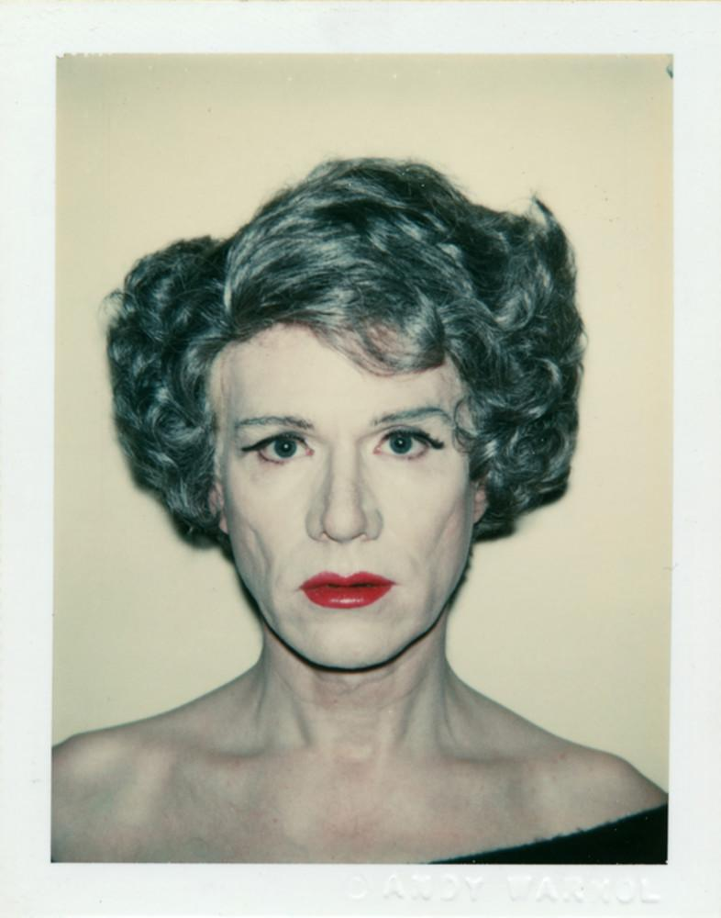
Why Warhol?
Andy Warhol lived through one of the most tumultuous periods of LGBTQ+ public life in American history.
As a prominent artist in one of the country’s LGBTQ+ epicenters, his life intersected with many important historical figures.
Warhol’s own life can be instructive in understanding the impacts of the gay rights movement, the AIDS crisis, and much more.
Andy Warhol, Self-Portrait in Drag, 1980
The Andy Warhol Museum, Pittsburgh;
Founding Collection, Contribution The Andy Warhol Foundation for the Visual Arts, Inc.
© The Andy Warhol Foundation for the Visual Arts, Inc
1998-1-2910

Slide 4
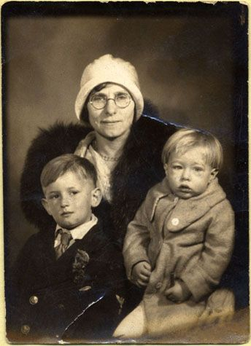
Early Family Life
On August 6, 1928, Andrew Warhola is born the third and final son of Julia and Andrej Warhola, two Carpatho-Rusyn immigrants in Pittsburgh, PA.
The family are devout Byzantine Catholics, and regularly attend mass and observe the customs of their Eastern European heritage.
Unknown, Julia, John, and Andy Warhola, 1932
The Andy Warhol Museum, Pittsburgh; Founding Collection, Contribution The Andy Warhol Foundation for the Visual Arts, Inc
1998.3.5247.
Notes:
Additional Notes
About the Art: Unknown, Julia, John, and Andy Warhola, 1932.
The Warhola family was quite poor, but this portrait depicts Andy, his mother and his older brother in distinguished attire. In the 1930s, it was common for portrait studios to have a rack of expensive clothing available for impoverished customers who wanted to look glamorous in their portraits.
Historical Context: In 1926, The New York Times became the first major publication to use the word “homosexuality”.

Slide 5
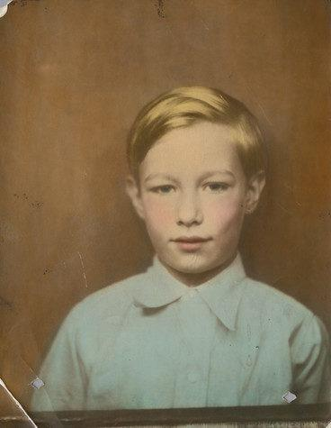
Childhood
Andrew is a frail, sickly child who often stays home from school after he contracts Rheumatic Fever in 1936.
His mother keeps him company, and encourages him to occupy his time drawing, photographing, and scrapbooking.
Warhol’s father dies in 1942. The thirteen-year-old Warhol is traumatized by the custom of leaving his father’s body in the living room for three days.
Unknown, Andy Warhol as a young boy, ca. 1936
The Andy Warhol Museum, Pittsburgh; Founding Collection, Contribution The Andy Warhol Foundation for the Visual Arts, Inc
1998.3.5218.
Notes:
Additional Notes
About the Art: Unknown, Andy Warhol as a young boy, ca. 1936.
In the days before color photography, black-and-white photos would be colored by hand using watercolors or other pigments.
Historical Context: In 1938, the word “Gay” is used for the first time in reference to homosexuality.

Slide 6
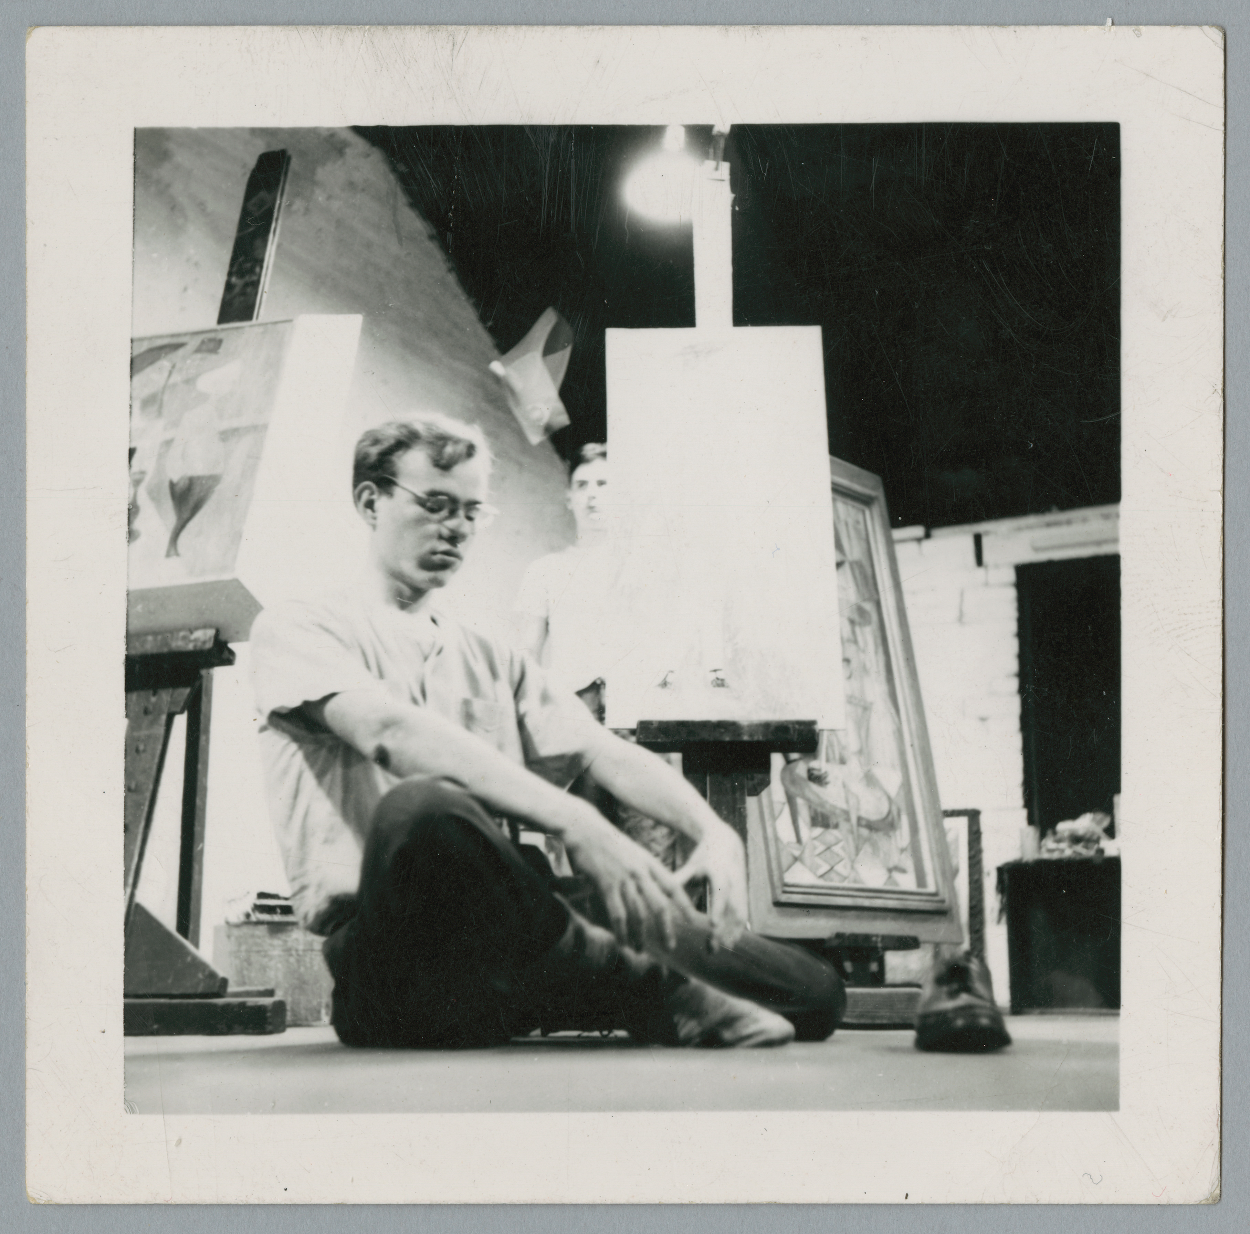
Art School
In 1945, Warhol begins studying pictorial design at Carnegie Technical Institute. He continues to live at home throughout college.
He participates in theater, filmmaking, and the modern dance club.
During the summer he works in the displays department of the Joseph Horne Company department store.
Unknown photographer, Andy Warhol with his “Nosepicker” painting and classmates, Arthur Elias, ca. 1948
The Andy Warhol Museum, Pittsburgh; Founding Collection, Contribution The Andy Warhol Foundation for the Visual Arts, Inc.
1998.3.5241.4
Notes:
Additonal Notes
Historical Context: Upon the liberation of Nazi concentration camps by Allied forces in 1945, those interned for homosexuality are not freed, but required to serve out the full term of their sentences.

Slide 7
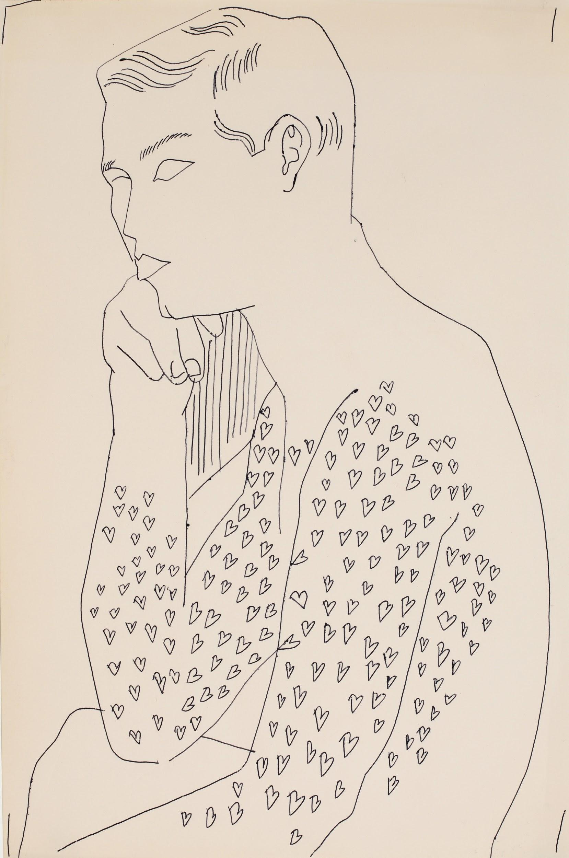
Advertising Career
In 1949, Warhol graduates and immediately moves to New York City. His first big break is illustrating a Glamour article titled “What is Success?”
Warhol’s commercial work takes off quickly, and he becomes a highly sought-after advertising illustrator.
He is particularly associated with fashion, thanks to high-profile clients like Fleming Joffe and I. Miller.
Andy Warhol, Male nude with hearts (Seated male nude torso), 1950s
The Andy Warhol Museum, Pittsburgh; Founding Collection, Contribution The Andy Warhol Foundation for the Visual Arts, Inc. © The Andy Warhol Foundation for the Visual Arts, Inc.
1998.1.1692
Notes:
Additional Notes
About the Art: Andy Warhol, Male nude with hearts (Seated male nude torso), 1950s.
This is an example of one of Warhol’s Boy Book drawings featured on Slide 13. Both his commercial art and his personal projects of the 1950s often feature playful, feminine flourishes such as decorative hearts, flowers, or butterflies.

Slide 8
“You’re just too swish.”
There was nothing I could say to that. It was all true. I decided that I just wasn't going to care, those were all things that I didn't want to change anyway, that I didn't think I should change.
Andy Warhol and Pat Hackett, POPism: The Warhol 60’s, 1980.
Notes:
Additional Notes
According to Warhol’s friend Emile de Antonio, the prominent artists Jasper Johns and Robert Rauschenberg disapproved of Warhol because he was “too swish.” In the mid-20th century, “swish” was a derogatory slang term used to describe especially effeminate and flamboyant gay men.

Slide 9
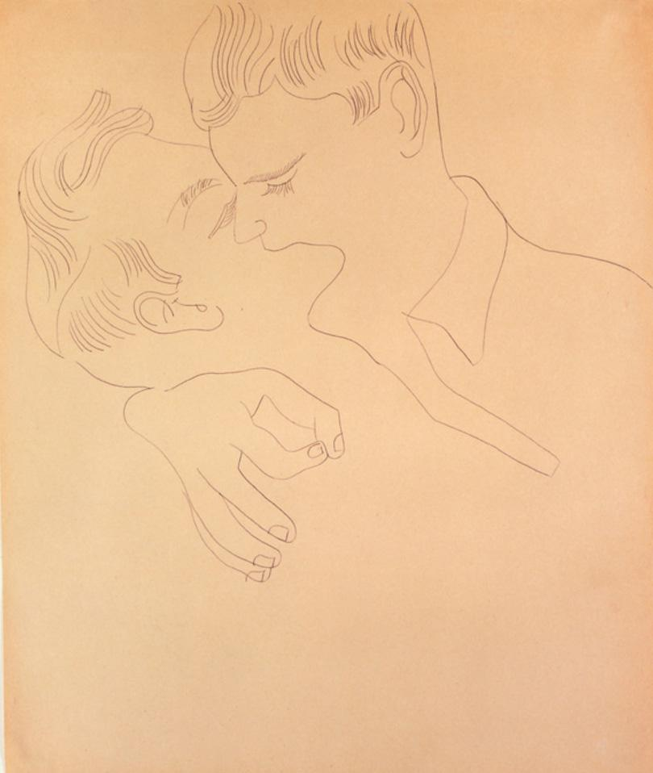
1950s
Warhol gains success in advertising but struggles to break into the fine art world.
He faces rejection from both galleries and other artists, who are uncomfortable with his overt homoeroticism.
More confident in his artistic skills than his social skills, Warhol networks and flirts by doing observational drawing portraits of men he finds attractive.
Andy Warhol, Male Couple, 1950s
The Andy Warhol Museum, Pittsburgh; Founding Collection, Contribution The Andy Warhol Foundation for the Visual Arts, Inc.
© The Andy Warhol Foundation for the Visual Arts, Inc.
1998.1.1701
Notes:
Additional Notes
About the Art: Andy Warhol, Male Couple, 1950s.
Robert Fleisher:- “I became very, very friendly with Andy. He used to come over to my apartment on 76th Street. He used to come quite often. He always wanted to sketch me. At the same time, just about that time, I became a model. I was photographed a lot, and I was in retailing but earned part of my income by modeling and Andy used to sketch and sketch and sketch and sketch... He said he was going to do what he called his 'Boy Book,' and he wanted all of us to pose nude, and we did. There was loads of us... “ - From Warholstars.org
Historical Context: As LGBTQ+ visibility increases there is an increase in push back from authorities. In 1950 The Mattachine Society, the first sustained American homosexual group, is founded in Los Angeles. But also in 1950, 190 individuals in the United States are dismissed from government employment for their sexual orientation, commencing the Lavender scare. 1954 Mathematical and computer genius Alan Turing commits suicide by cyanide poisoning, 18 months after being given a choice between two years in prison or libido-reducing hormone treatment for a year as a punishment for homosexuality. By the end of the decade there are underground communities in most major cities. In 1959 rioters are arrested at the first homosexual uprising in the world, at Cooper’s Doughnuts in Los Angeles.

Slide 10
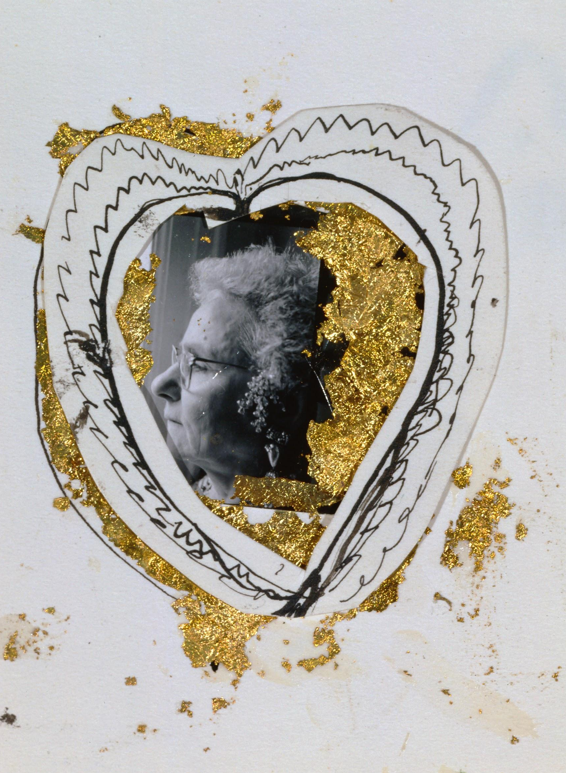
Julia and Andy
Julia Warhola moves to New York, where she lives with her son from 1951 until 1971.
At first she would say she was only staying until Andy got married.
By the end of her life she would be quoted as saying she wished that Andy would “get engaged and marry one of the boys,” because “maybe he would get a little baby, I mean a little Andy.”
Andy Warhol, Julia Warhola, ca. 1957
The Andy Warhol Museum, Pittsburgh; Founding Collection, Contribution The Andy Warhol Foundation for the Visual Arts, Inc.
© The Andy Warhol Foundation for the Visual Arts, Inc.
1998-1-2052
Notes:
Additional Notes
About the Art: Andy Warhol, Julia Warhola, ca. 1957.
In the 1950s, Andy and Julia often collaborated on Warhol’s commercial art projects. He used fountain pens and gold leaf to create many of his illustrations during this decade, and he has used those same materials to embellish this photograph of his mother.
Other notes: Julia quoted in David Bourdon, Warhol, p. 308.

Slide 11
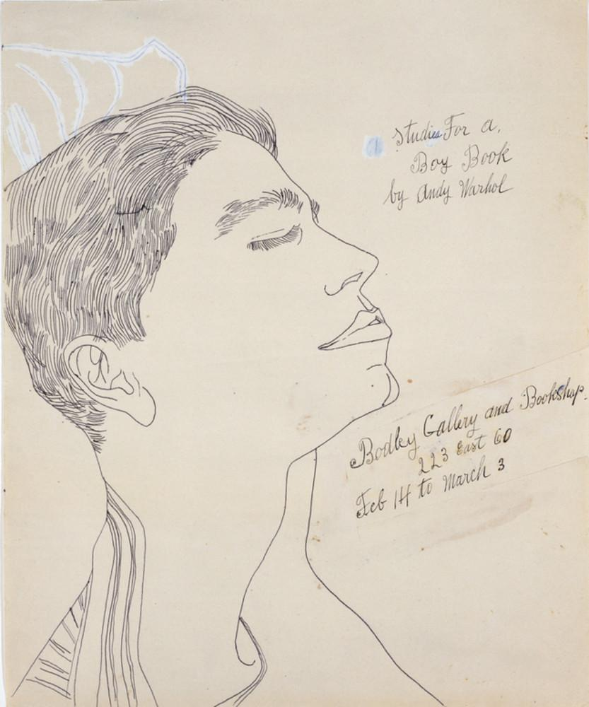
Boy Book Drawings
The Tanager Gallery (which is known for its support of emerging artists) rejects Warhol, saying his drawings “weren’t anything we wanted the gallery to be associated with.”
“Studies for a Boy Book,” an exhibition of Warhol’s intimate sketches of other men, runs for two weeks at the Bodley Gallery in 1956.
The known print reviews avoid mentioning the show’s frank expression of same-sex desire.
Andy Warhol, Studies From A Boy Book, 1956
The Andy Warhol Museum, Pittsburgh; Founding Collection, Contribution The Andy Warhol Foundation for the Visual Arts, Inc.
© The Andy Warhol Foundation for the Visual Arts, Inc.
1998.1.1847
Notes:
Additional Notes
About the Art: Andy Warhol, Studies From A Boy Book, 1956.
Ronald Vance authored a review of Warhol’s Boy Book exhibition for the March 1956 issue of Art News magazine. He wrote: “Andy Warhol’s Drawings for a Boy Book comment, inevitably often cruelly, by means of a hard psychological line and such symbolism as strings of inverted hearts on the young men. For example, Tom’s head narcissistically is lifted with closed, rather eyeless eyes to an anonymous pair of lips suspended in space. Prices unquoted.”
Other Notes: The Tanager Gallery operated from 1952-1962 in New York City. The gallery was one of the first artist cooperative galleries formed on 10th Street in Manhattan to provide an alternative to the larger upscale galleries of Madison Avenue. From 1952 to 1962, the Tanager Gallery exhibited works from about 250 artists.
The opening of Tanager and other 10th Street galleries was a radical change for the New York arts scene and for emerging New York artists who generally found representation with uptown gallery owners and/or art dealers on 57th Street or Madison Ave. In the 1950s, Manhattan's 10th Street was a gathering place for young artist-bohemians. The galleries were often the centers for anything avant-garde or new, such as art installations, happenings, poetry readings, jazz sessions, and performance art. For example, Tanager Gallery hosted a series of forums with local artists who would discuss their work and objectives.

Slide 12
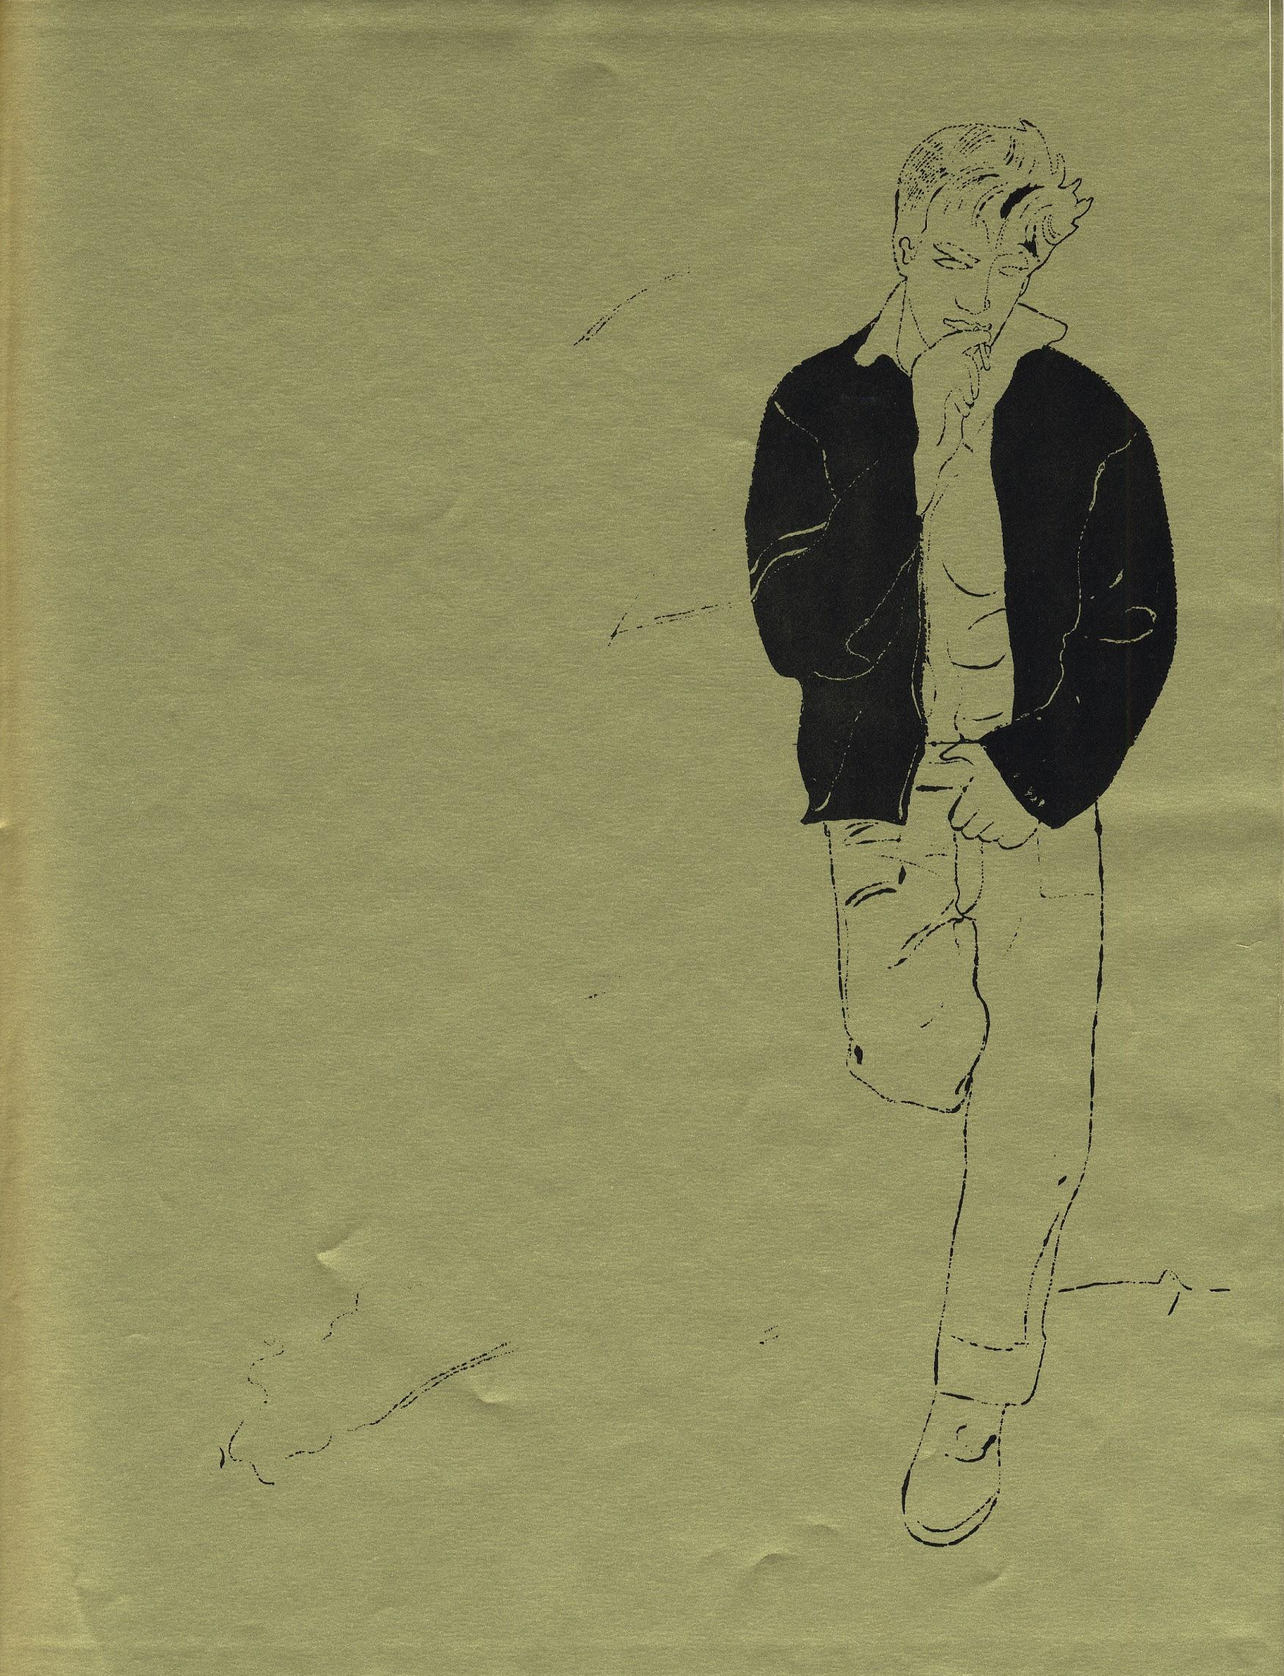
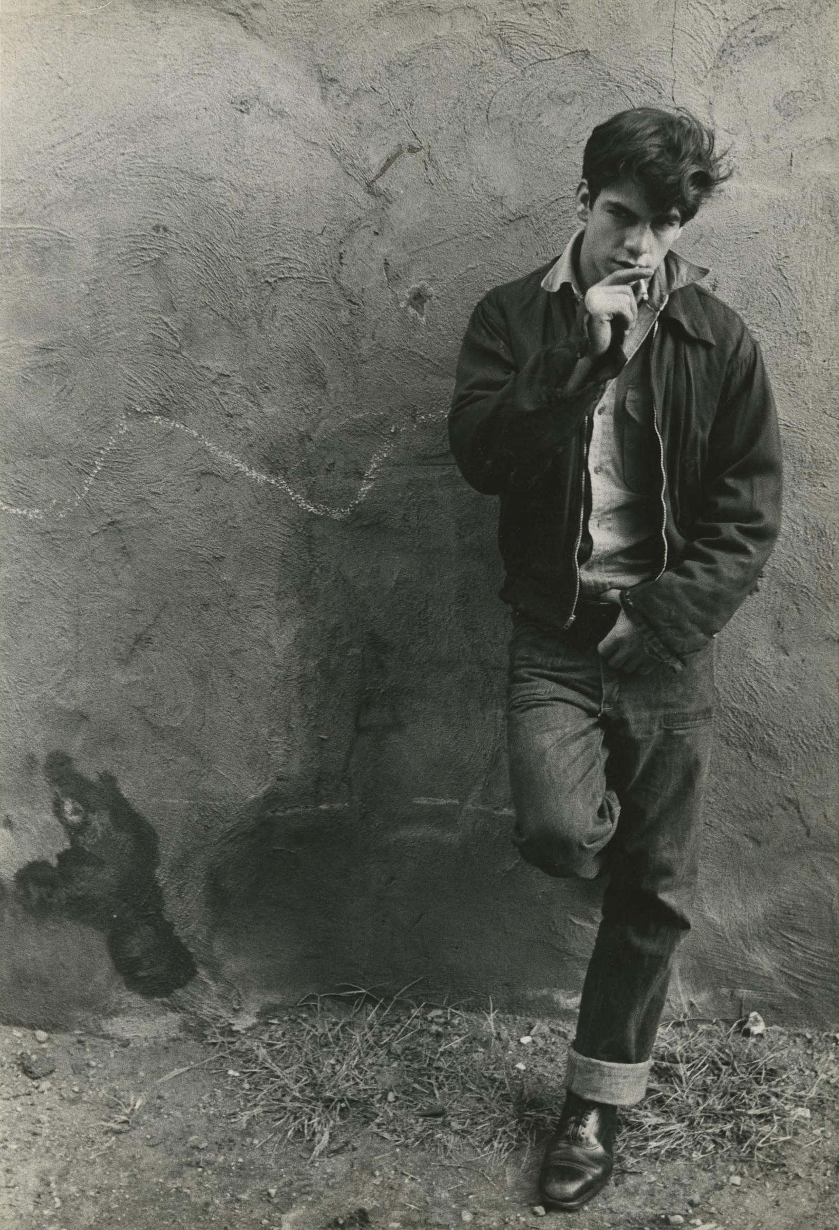
Early Boyfriends
Warhol has a lifelong pattern of collaborating artistically with the men he dates.
In 1950 Warhol begins a relationship with his first boyfriend, Carlton Willers. Willers is a librarian, and helps Warhol research source images.
In 1956, Warhol begins dating Ed Wallowitch and using his photographs as source material. Warhol and Wallowitch collaborate closely until 1962.
L: Andy Warhol, Illustration from A Gold Book, 1998.3.2427
R: Ed Wallowitch, Untitled (Source image) 01.1998.3.5392
The Andy Warhol Foundation for the Visual Arts, Inc.
© The Andy Warhol Foundation for the Visual Arts, Inc.
Notes:
Additional Notes
About the Art: Andy Warhol, A Gold Book, 1957
These images show how Warhol & Wallowitch collaborated during the years they were dating. Wallowitch would photograph strangers on the streets of New York City, and Warhol would trace the photographs with a fountain pen using his blotted-line technique.

Slide 13
As late as '67 drag queens still weren't accepted in the mainstream freak circles. They were still hanging around where they'd always hung around - on the fringe… But then ... people began identifying a little more with drag queens, seeing them more as ‘sexual radicals’.
Andy Warhol and Pat Hackett, POPism: The Warhol 60’s, 1980.

Slide 14
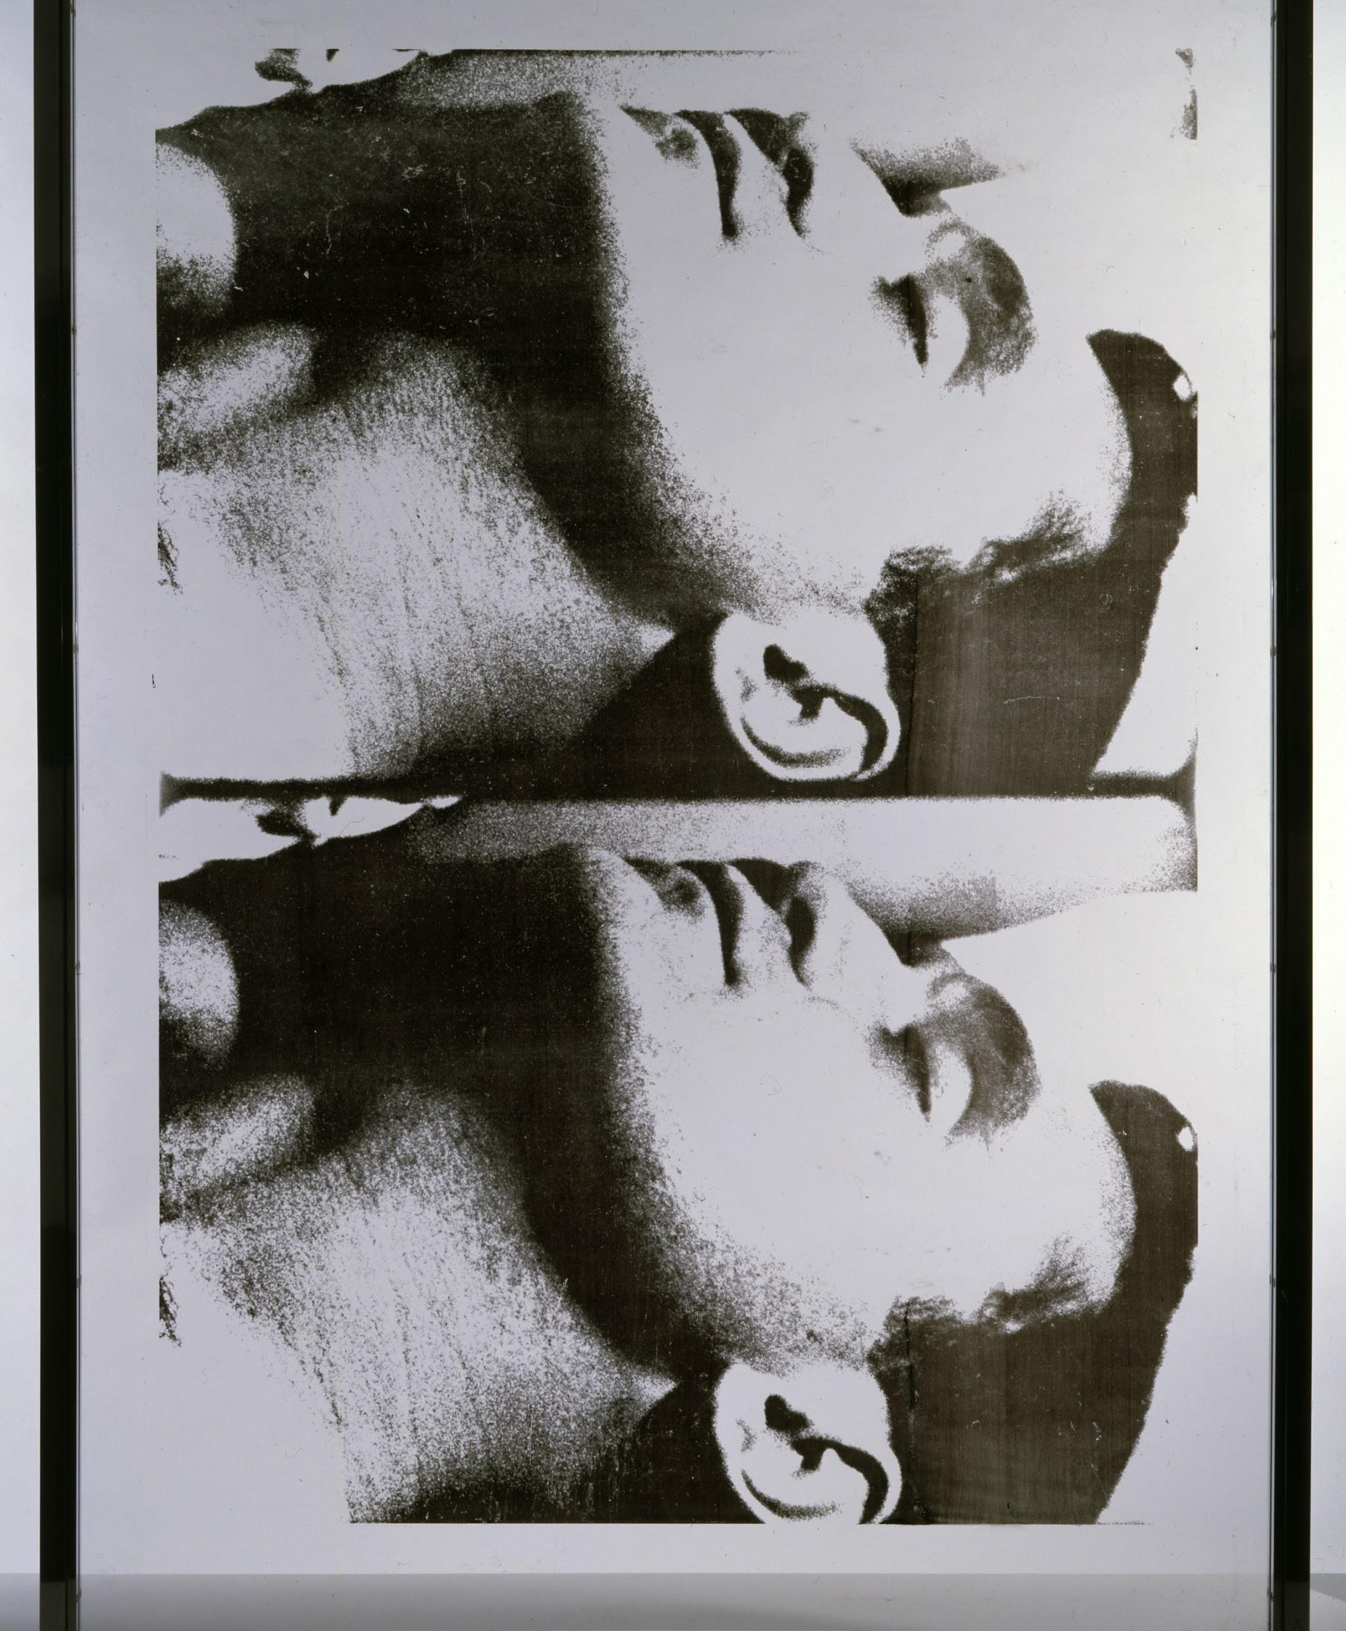
1960s
During the 1960s Warhol finds great success in the fine art world through his experimentation with Pop Art. He produces many of his signature works in rapid succession.
Various radical social movements enable Warhol to surround himself with a diverse social circle. He dubs them “Superstars” and they perform in his work and become active collaborators. His studio, the Factory, functions as a hub for the broader creative and LGBTQ+ communities.
Andy Warhol, Large Sleep, 1965
The Andy Warhol Museum, Pittsburgh; Founding Collection, Contribution The Andy Warhol Foundation for the Visual Arts, Inc.
© The Andy Warhol Foundation for the Visual Arts, Inc.
1998.1.2375
Notes:
Additional Notes
About the Art: Andy Warhol, Large Sleep, 1965
Warhol’s first film, Sleep, is a 5 ½ hour silent film of his boyfriend, the poet John Giorno, sleeping in the nude. It shows Giorno’s body from a variety of different angles, but at the time, the scandalous nudity was overshadowed by the incredible length of the film.

Slide 15
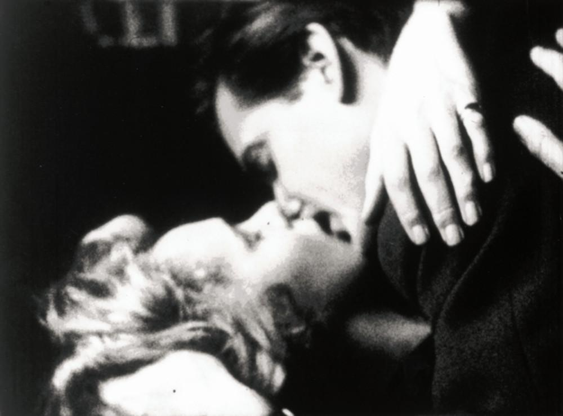
Controversial Work
In 1963 Warhol shoots his suggestive first film, Sleep, starring his boyfriend John Giorno.
Later in 1963, Warhol films Kiss, which depicts straight, gay, white, and interracial couples kissing.
The 1964 Warhol films Blow Job and Couch, feature suggestive titles, nudity, and transgressive sex scenes.
Andy Warhol, Kiss, 1964
©2020 The Andy Warhol Museum, Pittsburgh, PA, a museum of Carnegie Institute. All rights reserved.
Film still courtesy The Andy Warhol Museum
1997.4.81.1
Notes:
Additional Notes
About the Art: Andy Warhol, Kiss, 1963.
Warhol encountered persistent struggles with censors throughout his career, particularly in regards to his film work and it’s frank depictions of same-sex desire, BDSM, unsimulated sex, and cross-dressing. Although Warhol himself was never arrested for his controverisal filmmaking, police occasionally raided his studio or the theaters where his films were shown.

Slide 16
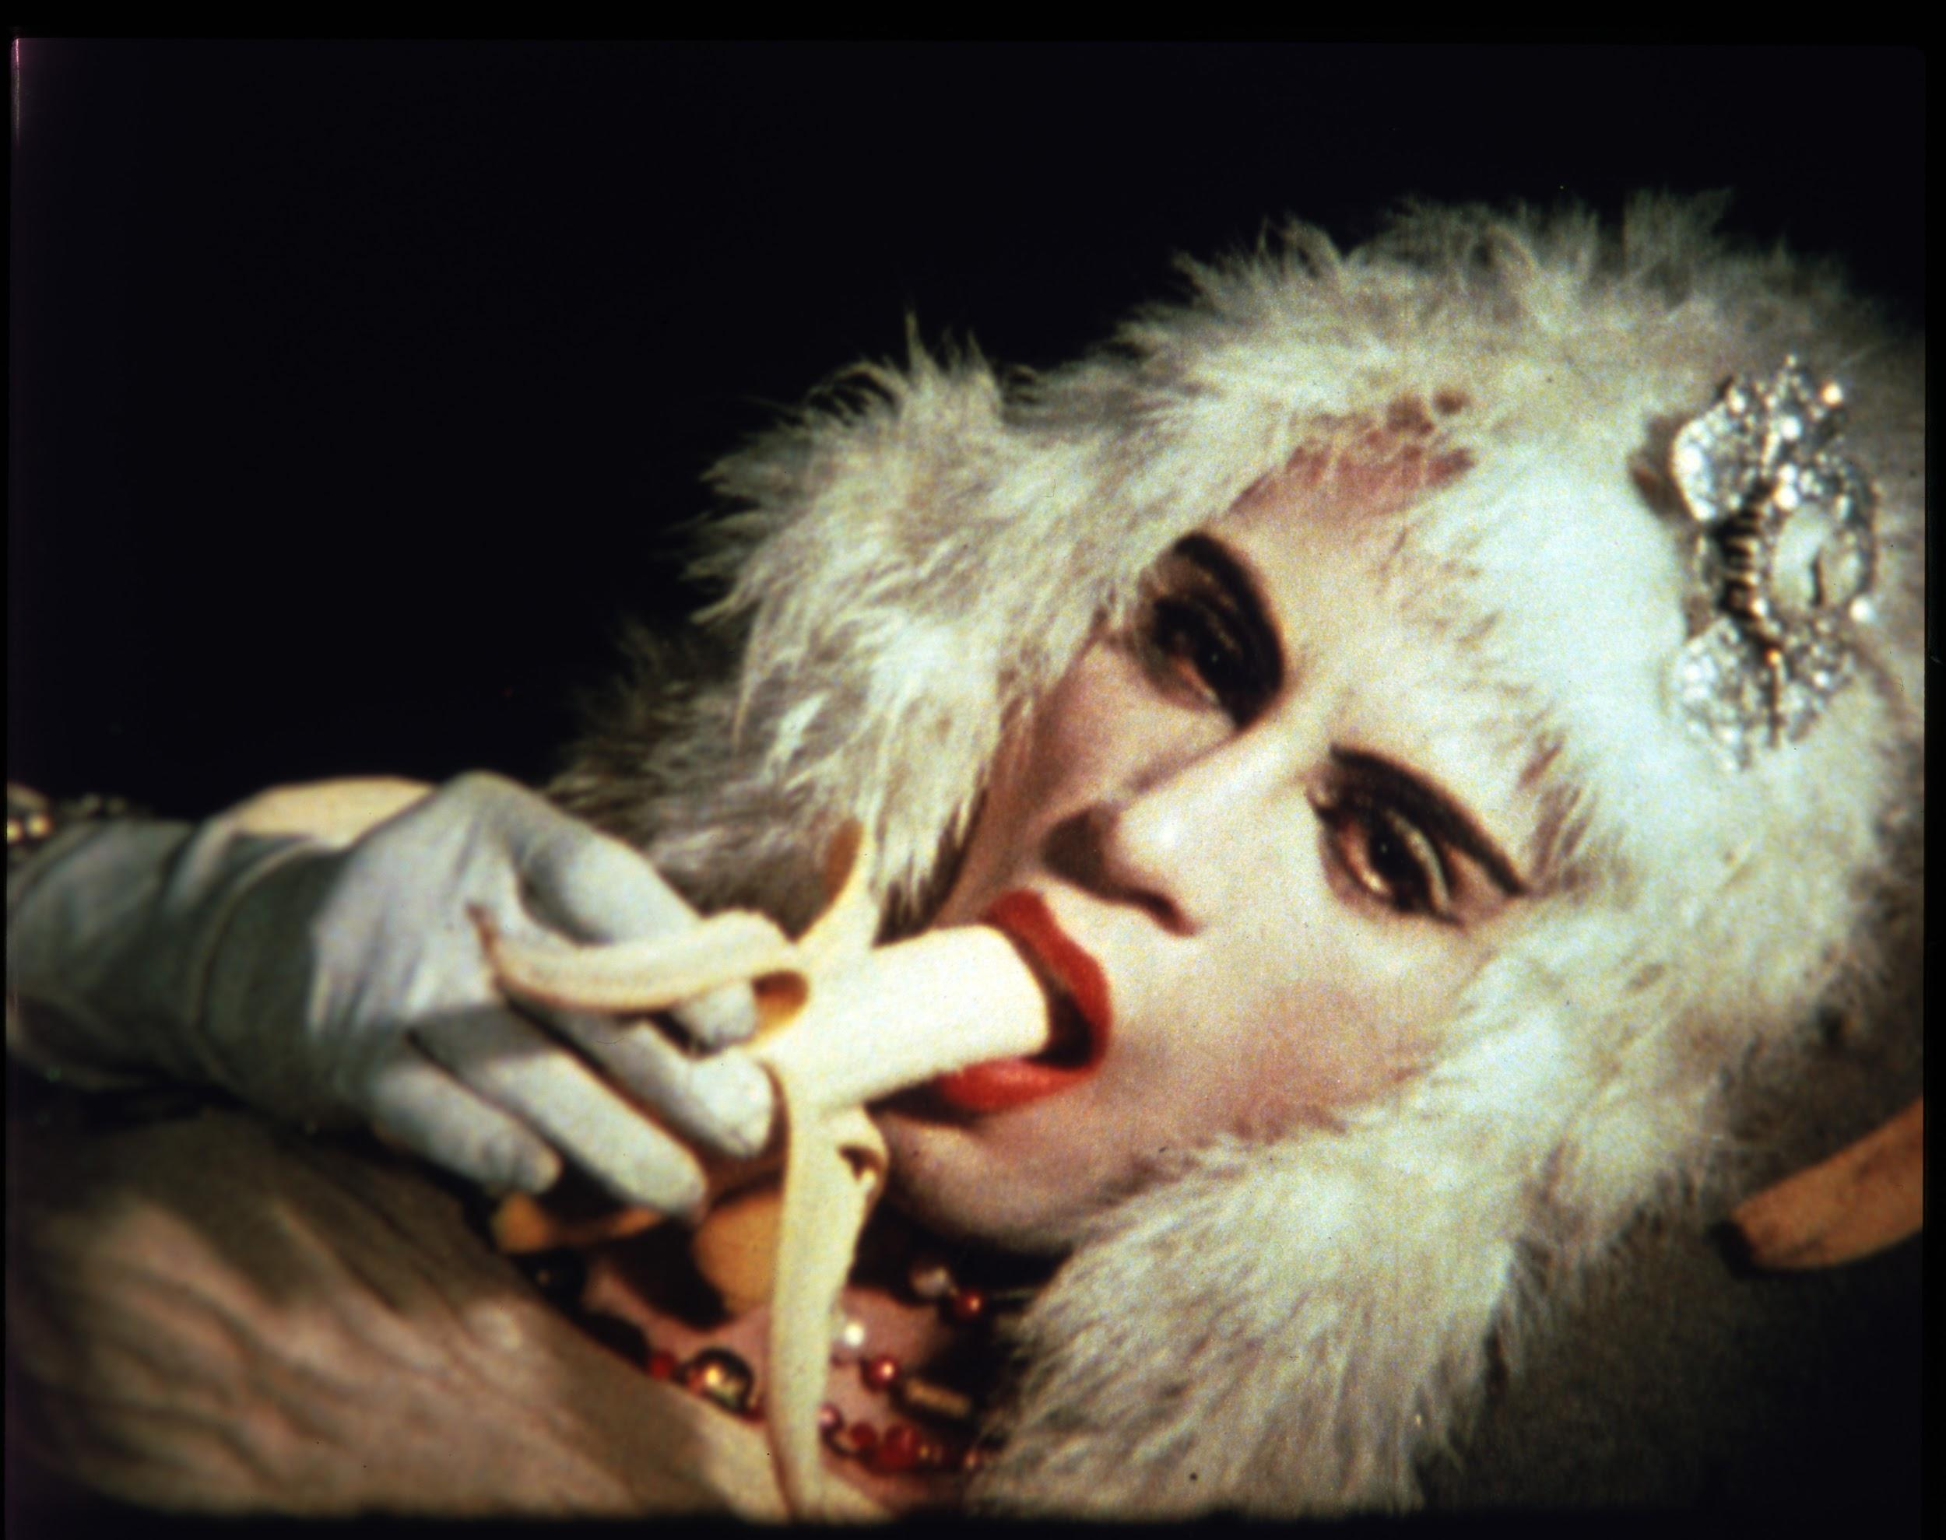
Outsider Subjects
In 1964, Warhol’s films begin incorporating the drag queen Mario Montez. Mario appears in fourteen Warhol films over the next two years.
In 1967, Warhol meets trans icons Candy Darling and Jackie Curtis, and casts them both in Flesh (1968).
In a 1973 interview, Warhol says “the people we use aren’t really drag queens, because drag queens are people who just dress up for like eight hours a day.”
Andy Warhol, Mario Banana #1, 1963-1964
©2020 The Andy Warhol Museum, Pittsburgh, PA, a museum of Carnegie Institute. All rights reserved.
Film still courtesy The Andy Warhol Museum
1997.4.71
Notes:
Additional Notes
Historical Context:
April 17, 1965- First picket at the White House by members of the New York City and Washington, D.C. chapters of the Mattachine Society, Philadelphia’s Janus Society and the New York chapter of the Daughters of Bilitis.
August 1966- transgender women hold The Compton’s Cafeteria Riot.
Other Notes: The Warhol quote about drag queens is from David Bailey, Warhol (1973). See here for more information about the at-the-time banned long-form Warhol interview/documentary: https://reprobatepress.com/2018/12/29/when-david-bailey-met-andy-warhol-the-banned-tv-documentary/

Slide 17
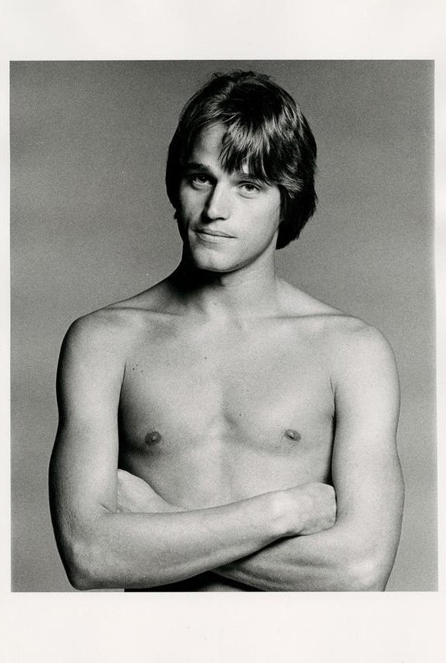
On June 3, 1968 radical writer and activist Valerie Solanas shoots Andy Warhol.
Jed Johnson, an assistant at the Factory, moves into Warhol’s townhouse to help him recover from the shooting. A romance develops between the two men, which becomes Warhol’s longest relationship. Julia Warhola lives with them.
Jed organizes Warhol’s home and decorates the office of his magazine, Interview, leading to a prestigious interior design career.
Shooting & Recovery
Francesco Scavullo, Envelope containing photographs of Jed Johnson, date unknown
The Andy Warhol Museum, Pittsburgh; Founding Collection, Contribution The Andy Warhol Foundation for the Visual Arts, Inc.
1998.3.6630.1-1998.3.6630.5
Notes:
Additional Notes
Warhol was pronounced clinically dead for one and a half minutes before the doctors revived him. They operated for five and a half hours, removing his spleen. He was in critical condition, but survived.​
​Valerie Solanas:​
She was an author of screenplays and essays as well as a women’s rights activist, who pushed feminism to radical new heights in 1967, when she founded the Society for Cutting Up Men (she was its only member) and self-published the SCUM Manifesto.​
There are varying theories as to why she shot Warhol. One was that she was outraged by his rejection of a play she had written and hoped that he would produce. The other theory was that this was as a publicity stunt. She wanted media attention so that she could start a drastic women’s revolution which she hoped would result in the total elimination of the male gender.​
Solanas did appear in one of Warhol’s films but she did not identify as an actress. ​
Solanas pleaded guilty to reckless assault with intent to harm and was sentenced to three years in prison. She was later diagnosed with schizophrenia.​

Slide 18
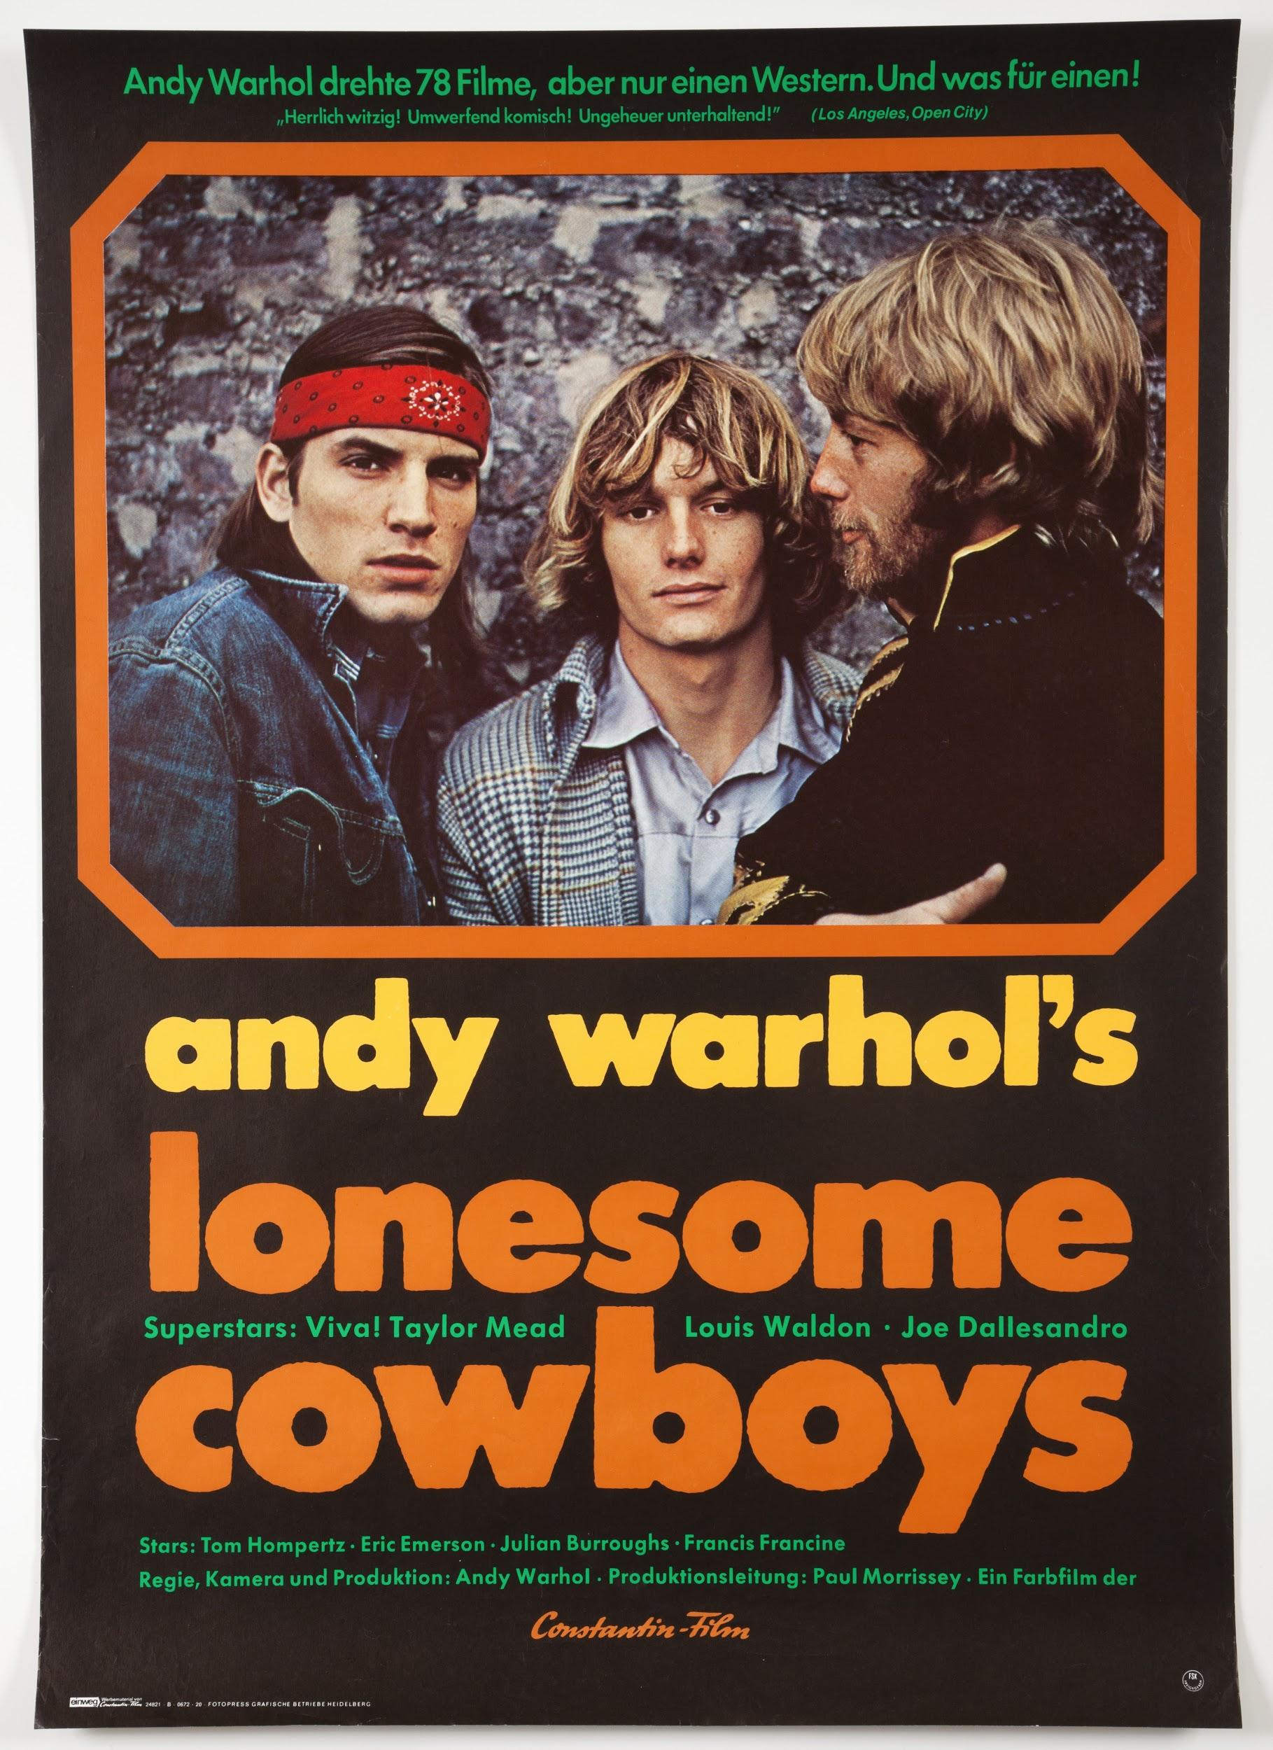
On June 28, 1969, the Stonewall Riots catapult the modern LGBTQ+ movement into mainstream America. The anniversary is the foundation of contemporary Pride celebrations.
On August 5, 1969, a screening of Warhol’s Lonesome Cowboys in Atlanta, GA is raided by law enforcement on obscenity charges. The projectionist is taken into custody, and officers photograph the members of the audience.
Gay Rights Movement
Constantin Films, Film Poster (“Lonesome Cowboys”), ca. 1968
The Andy Warhol Museum, Pittsburgh; Founding Collection, Contribution The Andy Warhol Foundation for the Visual Arts, Inc.
MISC 03-0019
Notes:
Additional Notes
About the Art: Constantin Films, Film Poster (“Lonesome Cowboys”), ca. 1968
The filming of Lonesome Cowboys in Arizona was monitored by the FBI on the suspicion that Warhol would be transporting obscene materials across state lines when he brought the film back to New York. Federal charges were never filed.
Barely a full month after the Stonewall Riots, a screening of Warhol’s Lonesome Cowboys at Ansley Mall Mini-Cinema in Atlanta, GA is raided by law enforcement. Obscenity charges are cited, as the projectionist was taken into custody, and officers photographed the members of the audience to show “what kind of people go to these movies.” The raid galvanized the LGBTQ+ community of Atlanta and sparked a wave of activism.
Other Notes: For more information on “The Stonewall of The South”, see:
https://www.smithsonianmag.com/history/stonewall-south-history-forgot-180972484/

Slide 19
People’s fantasies are what give them problems. If you didn’t have fantasies you wouldn’t have problems because you’d just take whatever was there. But then you wouldn’t have romance, because romance is finding your fantasy in people who don’t have it.
Andy Warhol, The Philosophy of Andy Warhol: From A To B And Back Again, 1975.

Slide 20
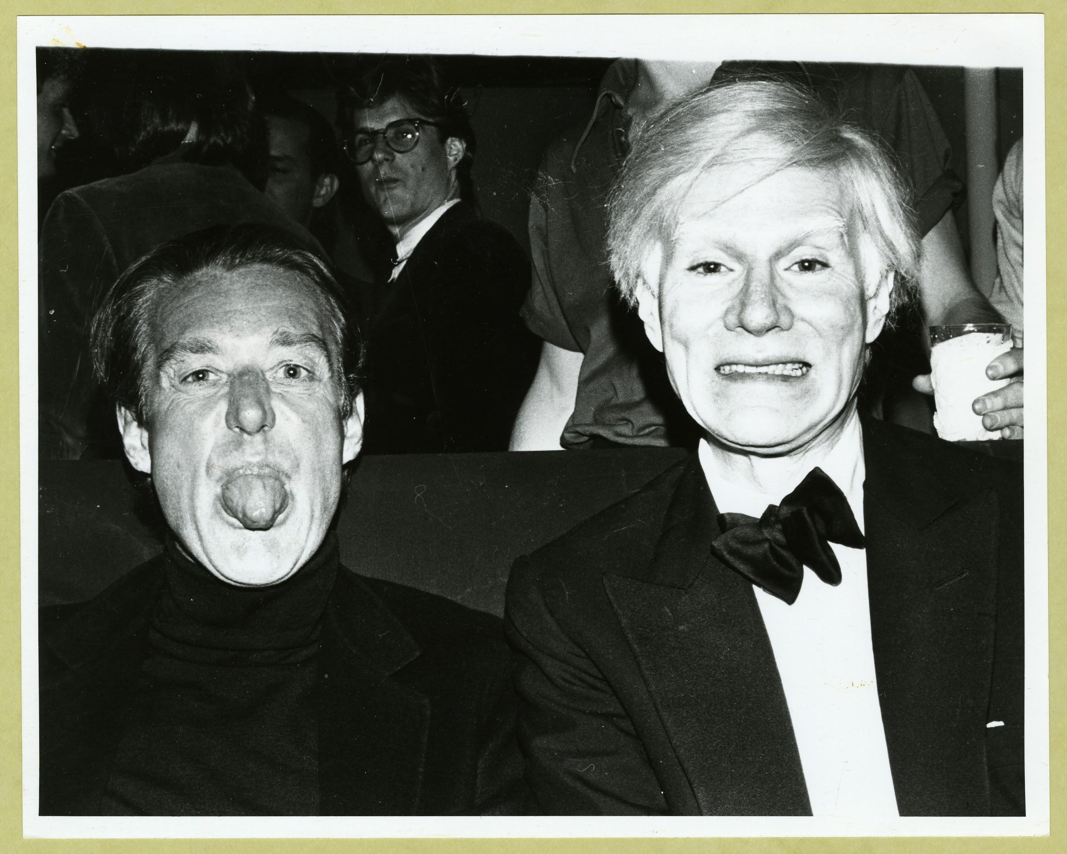
1970s
Although Warhol remains a very public figure, he retreats with Jed to his townhouse, which serves as his publishing office and studio. The 1968 shooting leaves his torso crossed with scars, and he needs to wear a surgical girdle for the rest of his life.
At night he is a fixture at clubs like Studio 54, with friends Halston, Valentino, Divine, John Waters, Patti Smith and Robert Mapplethorpe. He has become a celebrity in his own right.
unknown photographer, Halston and Andy Warhol, ca. 1979
The Andy Warhol Museum, Pittsburgh; Founding Collection, Contribution The Andy Warhol Foundation for the Visual Arts, Inc.
TC255.189.2
Notes:
Additional Notes
Historical Context:
June 28th, 1970-The first gay pride parades are held in New York City, Chicago and Los Angeles to commemorate the one-year anniversary of the Stonewall riots.
1972- Sweden becomes first country in the world to allow transsexuals to legally change their sex.
1973- The American Psychiatric Association removes homosexuality from its Diagnostic and Statistical Manual of Mental Disorders (DSM-II).
November 27th, 1978- San Francisco Supervisor Harvey Milk and Mayor George Moscone are assassinated by former Supervisor Dan White.
May 21st, 1979- The White Night Riots occur outside San Francisco City Hall after the announcement of a lenient sentence for Harvey Milk’s assassin Dan White.

Slide 21
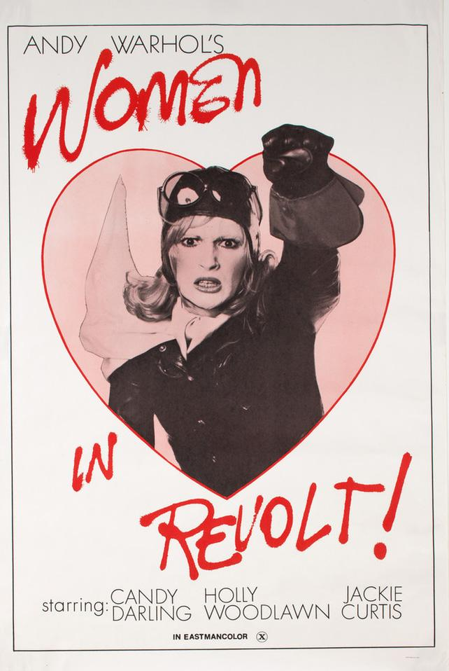
Following his recovery from the assassination attempt, Warhol tightens security at the Factory and pushes to professionalize his practice.
In 1970, he shifts to focus on lucrative commissioned portraits and documentary video projects like the Factory Diaries.
In 1971, Warhol releases Women In Revolt, a satire in which radical feminists are portrayed by drag queens and trans women.
Changing Processes
Film Poster (“Women In Revolt”)
The Andy Warhol Museum, Pittsburgh; Founding Collection, Contribution The Andy Warhol Foundation for the Visual Arts, Inc.
© The Andy Warhol Foundation for the Visual Arts, Inc. T124 int 01
Notes:
Additional Notes
About the Art: Film Poster (“Women In Revolt”)
Women In Revolt starred Candy Darling, Holly Woodlawn and Jackie Curtis as the founding members of a feminist group called PIGS: Politically Involved Girls.

Slide 22
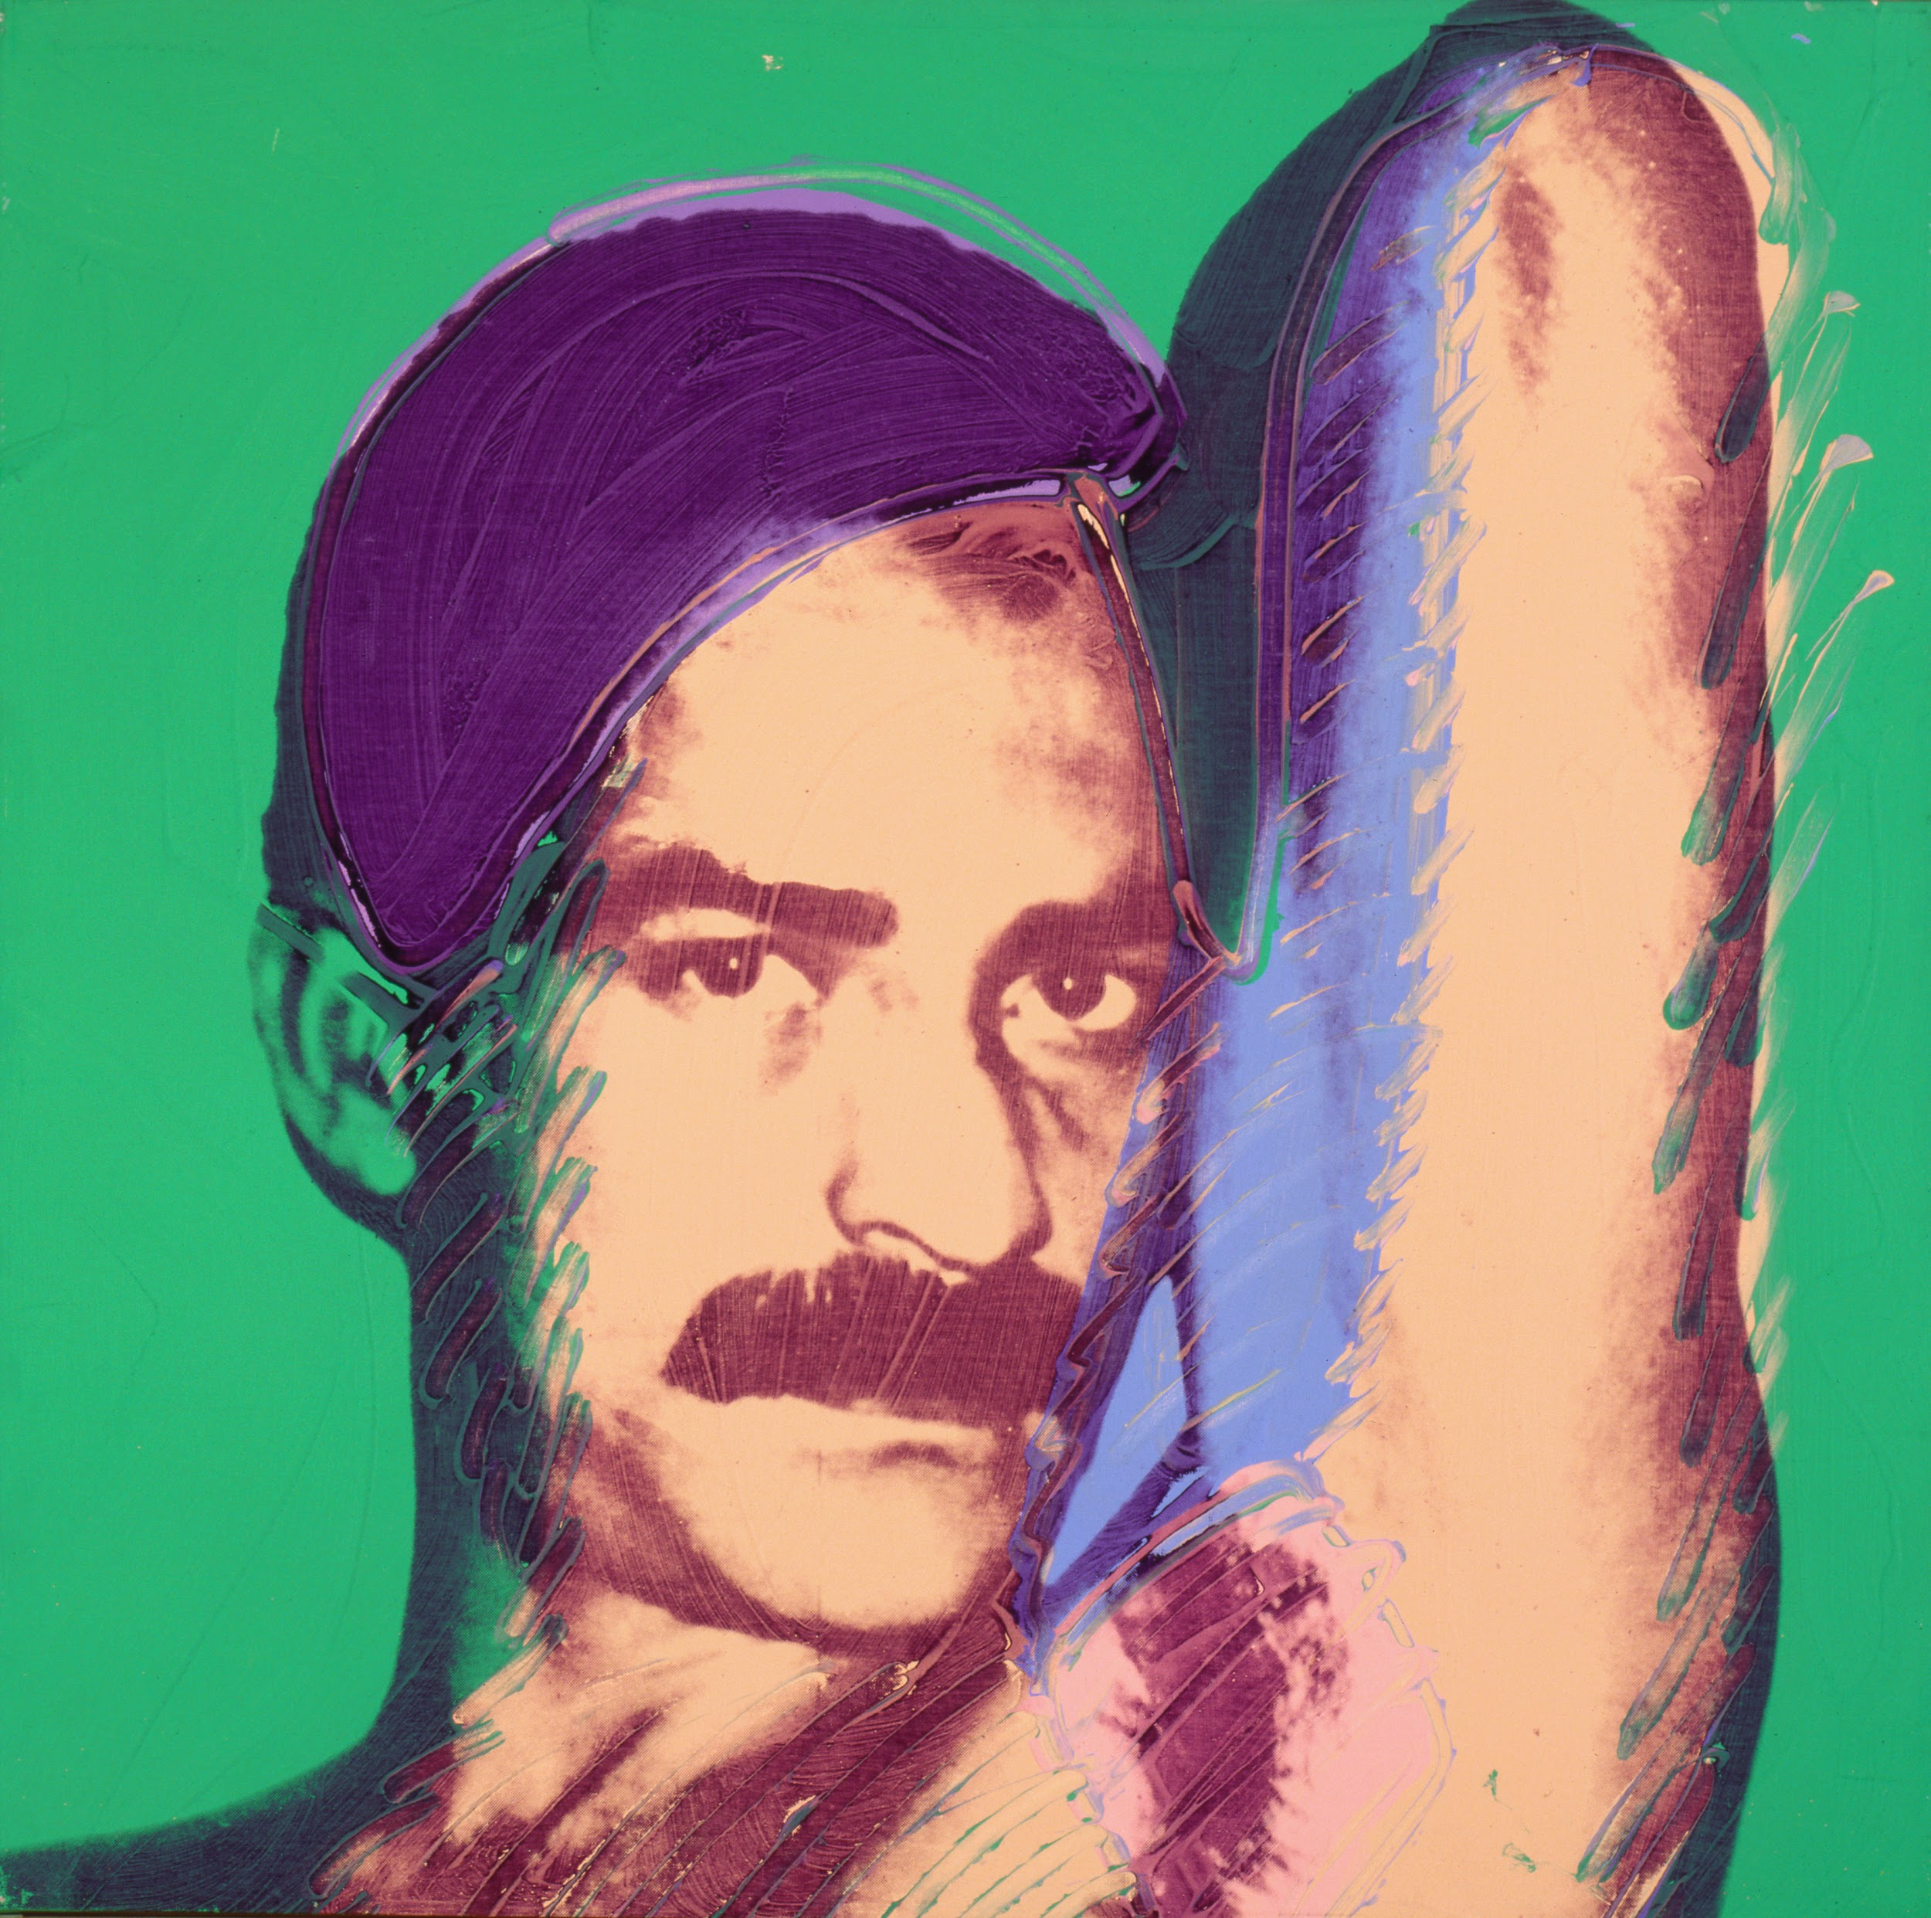
Halston & Hugo
In 1972, Warhol and prestigious fashion designer Halston collaborate for the first time.
Warhol produces a runway presentation for Halston at the Coty American Fashion Critics Awards, beginning over a decade of close collaboration.
Halston’s partner Victor Hugo becomes Warhol’s assistant, and acts as a liaison between the reserved Warhol and the emerging gay sexual underground.
Andy Warhol, Victor Hugo, 1978
The Andy Warhol Museum, Pittsburgh; Founding Collection, Contribution The Andy Warhol Foundation for the Visual Arts, Inc.
© The Andy Warhol Foundation for the Visual Arts, Inc.
1998.1.577
Notes:
Additional Notes
About the Art: Andy Warhol, Victor Hugo, 1978
Venezuelan artist Victor Hugo modeled for several of Warhol’s paintings and incorporated Warhol’s 1975 book, The Philosophy of Andy Warhol, into a window display for Halston.
Other Notes: For more about Warhol’s friendship with Halston, see https://www.biography.com/news/andy-warhol-halston-friendship

Slide 23
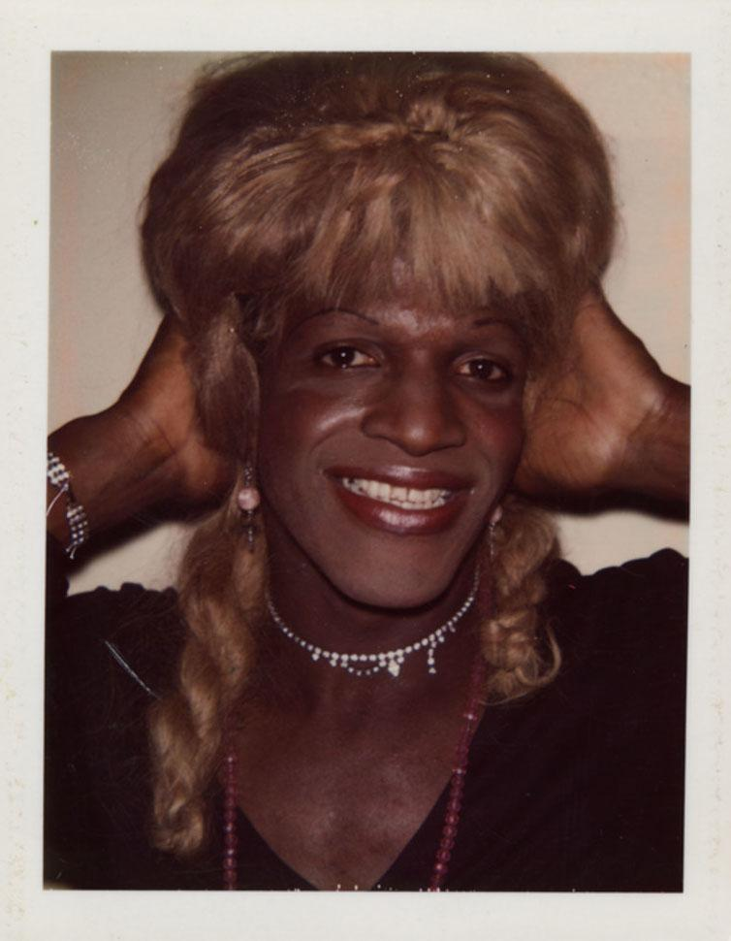
Ladies and Gentlemen
In 1974, Warhol completes his most lucrative commission—Ladies and Gentlemen, a series of over 200 striking portraits of African American and Latinx drag queens and trans women.
Among the fourteen models is iconic transgender performer and activist, Marsha 'Pay it No Mind' Johnson.
Andy Warhol, Drag Queen (Marsha P. Johnson), 1974
The Andy Warhol Museum, Pittsburgh; Founding Collection, Contribution The Andy Warhol Foundation for the Visual Arts, Inc.
© The Andy Warhol Foundation for the Visual Arts, Inc. 2001.2.1755
Notes:
Additional Notes
About the Art: Andy Warhol, Drag Queen (Marsha P. Johnson), 1974.
The subjects received just $50 to sit for Polaroids in Warhol’s studio, and they would not be individually named until 40 years later through research at The Andy Warhol Foundation for the Visual Arts. The series was commissioned by Italian art dealer Luciano Anselmino, and was set for 100-130 paintings, meaning that Warhol more than doubled the commissioned output.

Slide 24
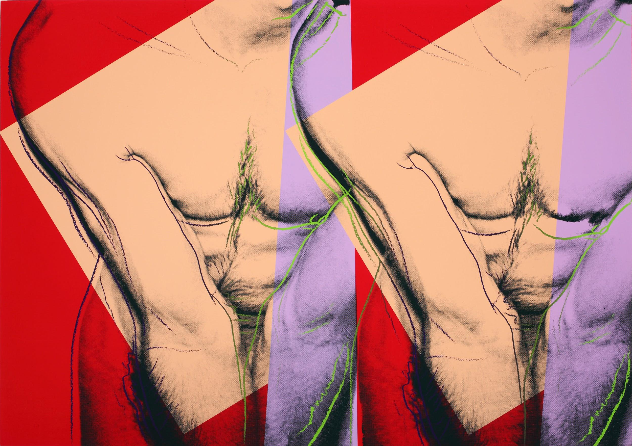
In 1977 Warhol begins work on two portfolios, Torso and Sex Parts. Torso paintings show at the Grand Palais in Paris, whereas Sex Parts are intended for private sale to collectors.
These silkscreen printed paintings were based on polaroids of anonymous subjects, including sex workers.
Warhol’s assistant Ronnie Cutrone wrote that “Sex Parts was a final announcement or affirmation of his homosexuality.”
Sex Parts and Torsos
Andy Warhol, Torso (Double), ca. 1982
The Andy Warhol Museum, Pittsburgh; Founding Collection, Contribution The Andy Warhol Foundation for the Visual Arts, Inc.
© The Andy Warhol Foundation for the Visual Arts, Inc.
1998.1.2644
Notes:
Additional Notes
The above Cutrone quote is from John O’Connor and Benjamin Liu, Unseen Warhol, p. 68.
About the Art: Andy Warhol, Torso (Double), ca. 1982.
“The seed of the Torsos and Sex Parts series sprouted after a man approached Warhol boasting of his large penis. Warhol agreed to photograph the man’s genitalia and the photographs were placed in a box casually labeled “Sex Parts.” Later, Warhol noticed the wording of the box’s label and conceived the idea for a series of works based on the initial photographs. Subjects for subsequent photo shoots were recruited from gay bath houses by Halston’s boyfriend, the artist and window dresser Victor Hugo. The men were asked to relax, pose, or take part in various sexual activities while Warhol photographed them with a 35mm camera and a Polaroid Big Shot. According to associate Bob Colacello, when confronted on the explicit nature of the photographs sitting around the office Warhol responded, ‘Just tell them it’s art, Bob. They’re landscapes.’” Bob Colacello, Holy Terror: Warhol Up Close, p. 337

Slide 25
I’ve got these desperate feelings that nothing means anything. And then I decide that I should try to fall in love, and that’s what I’m doing now with Jon Gould, but then it’s just too hard.
Andy Warhol, The Andy Warhol Diaries, 1981

Slide 26
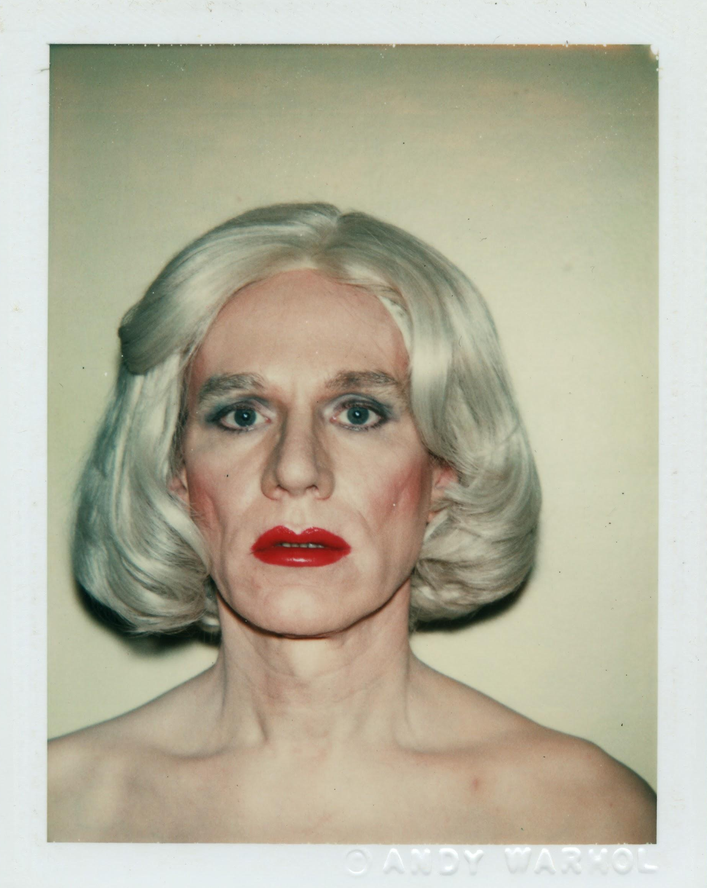
Warhol solidifies his brand with forays into a variety of new mediums, and his embrace of emergent young artists and celebrities.
Jed Johnson breaks up with Warhol and moves out of the townhouse. The two continue to share custody of their dogs, Amos & Archie.
AIDS decimates the LGBTQ+ community and pushes Warhol further into isolation. Despite his lifelong anxiety about health and his growing identification with this community, few Warhol works address the crisis directly.
1980s
Andy Warhol, Self-Portrait in Drag, 1981
The Andy Warhol Museum, Pittsburgh; Founding Collection, Contribution The Andy Warhol Foundation for the Visual Arts, Inc.
© The Andy Warhol Foundation for the Visual Arts.
1998.1.2918
Notes:
Additional Notes
About the Art: Andy Warhol (Self-Portrait in Drag), 1981.
In the early 1980s, Andy Warhol modeled for drag photoshoots with his friend and collaborator Christopher Makos. Warhol donned a variety of wigs, worked with multiple makeup artists, and experimented with both feminine clothing and his typical office attire.

Slide 27
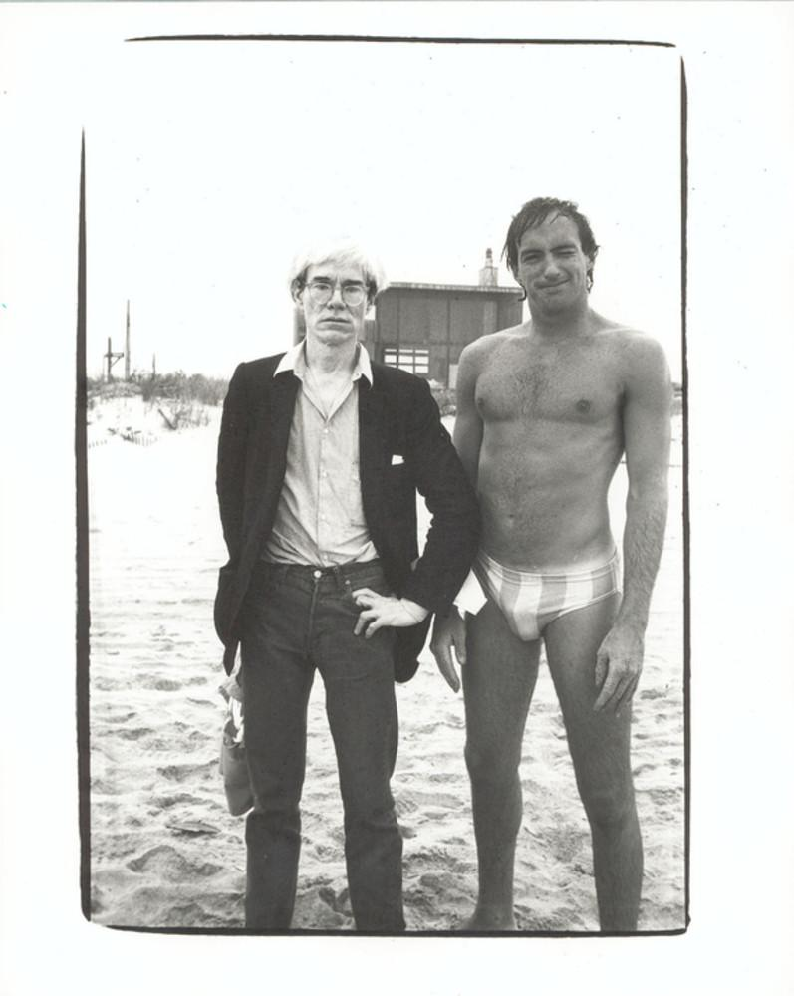
Mere days after the dissolution of his relationship with Jed Johnson in December of 1980, Warhol pursues a relationship with Paramount executive Jon Gould.
True to form, Warhol expresses interest by trying to get Gould to purchase advertising space in Interview.
The two attend Gould family events together “as close friends”, as Gould is not open about his sexuality.
Jon Gould
Andy Warhol, Andy Warhol and Jon Gould, ca. 1982
The Andy Warhol Museum, Pittsburgh; Founding Collection, Contribution The Andy Warhol Foundation for the Visual Arts, Inc. © The Andy Warhol Foundation for the Visual Arts, Inc. 2001.2.180
Notes:
Additional Notes
About the Art: Andy Warhol, Andy Warhol and Jon Gould, ca. 1982.
Jon Gould was an outdoorsy man who particularly loved the beach. Warhol was more indoorsy and he sunburned easily, but he indulged Gould with frequent trips to his beach house in Montauk.

Slide 28
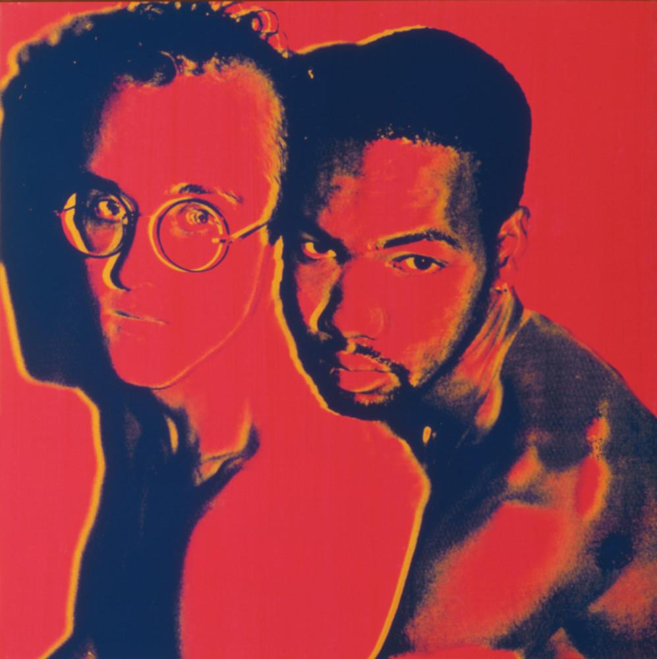
Collaborations
In 1982, Warhol begins collaborating with a younger generation of downtown painters, including gay and Black artists.
He becomes a mentor-like figure to Keith Haring and Jean-Michel Basquiat, and trades portraits with Robert Mapplethorpe.
Warhol paints a couples portrait of Haring with Juan Dubose.
Andy Warhol, Keith Haring and Juan Dubose, 1983
The Andy Warhol Museum, Pittsburgh; Founding Collection, Contribution The Andy Warhol Foundation for the Visual Arts, Inc.
© The Andy Warhol Foundation for the Visual Arts, Inc.
1998.1.563
Notes:
Additional Notes
About the Art: Andy Warhol, Keith Haring and Juan Dubose, 1983
Juan Dubose was an underground DJ in Brooklyn and he had a day job installing car stereos; he is most well known for his intense love affair with Keith Haring at the peak of his career. In 1982, Dubose and Haring spent several days cleaning up 40-50 bags worth of garbage piled up against a wall behind a handball court on the corner of Houston Street and the Bowery. Together they painted the first mural on the Bowery Graffiti Wall, which has become a cultural landmark where contemporary artists continue to paint to this day.
Historical Context: In August 1980 at the Democratic National Convention, the Democratic party becomes the first major political party in the U.S. to include gay rights in their platform.

Slide 29
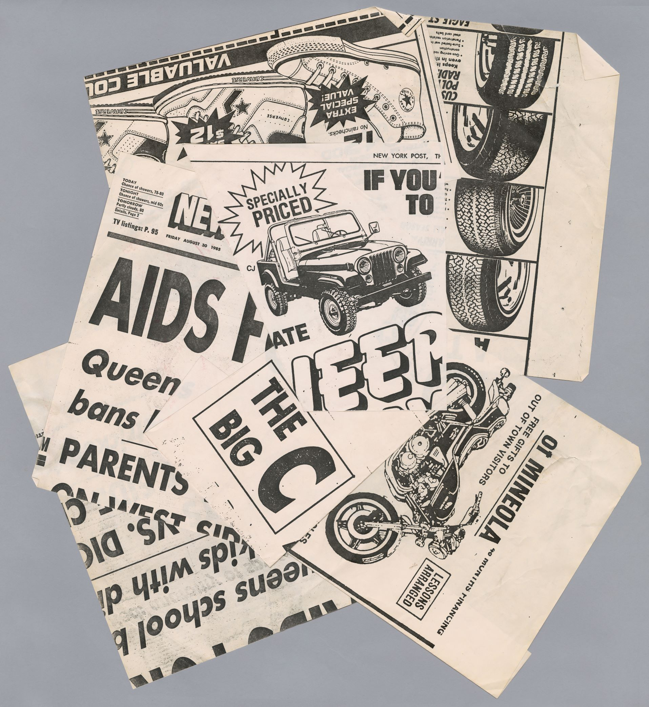
While Warhol created very few artworks that directly address the AIDS crisis, he often expresses anxiety about the disease in his diaries.
Warhol incorporates newspaper headlines referring to the disease into a few obscure paintings in 1985 and 1986.
The virus claims the life of Jon Gould in 1986, and Halston, Mapplethorpe, and Haring by 1990.
The AIDS Epidemic
Andy Warhol, Collage (photocopies of newspaper headlines and advertisements), 1985-1986
The Andy Warhol Museum, Pittsburgh; Founding Collection, Contribution The Andy Warhol Foundation for the Visual Arts, Inc. © The Andy Warhol Foundation for the Visual Arts, Inc. T3291
Notes:
Additional Notes
About the Art: Andy Warhol, Collage (photocopies of newspaper headlines and advertisements), 1985-1986.
This collage of newspaper headlines and advertisements served as source material for multiple different Warhol paintings, including the 1985-6 canvas AIDs, Bicycle, Jeep. The phrase “The Big C” refers to the colloquial name of AIDs at the time, “the gay cancer”, and Warhol incorporated this headline into figure studies of Christ for one of his Last Supper canvases.
Historical Context:
September 1982: The CDC used the term AIDS for the first time when it reported that an average of one to two cases of AIDS were being diagnosed in America every day.
October 2nd, 1985: Actor Rock Hudson dies of AIDS.
March 10th, 1987: AIDS advocacy group ACT UP (The AIDS Coalition to Unleash Power) is formed.
Other Notes:
For more, see Jessica Beck’s Warhol’s Confession: Love, Faith, and AIDS - https://www.warhol.org/warhols-confession-love-faith-and-aids/
Other Notes:
For more general information about the HIV/AIDS epidemic, see these resources
https://nycaidsmemorial.org/timeline/
https://www.hrc.org/resources/hrc-issue-brief-hiv-aids-and-the-lgbt-community
https://www.cdc.gov/hiv/basics/whatishiv.html

Slide 30
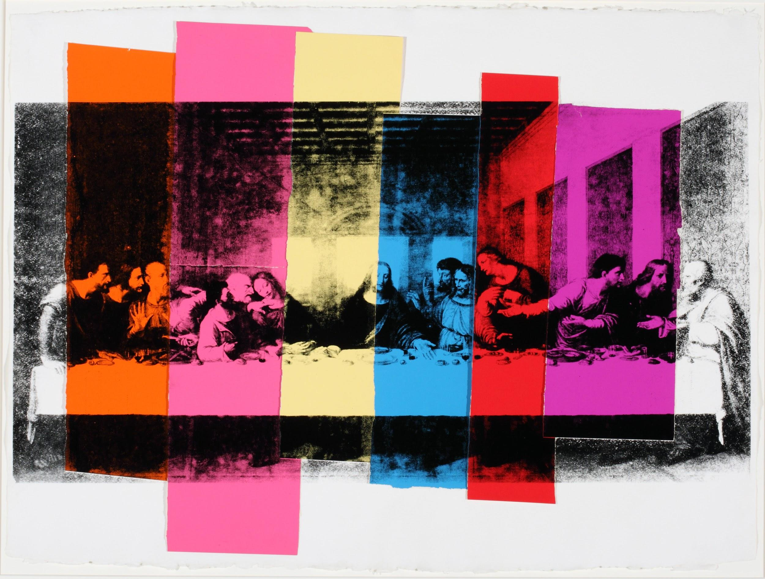
In 1986 Warhol creates a series of self-portraits overlaid with colorful camouflage patterns, juxtaposing his aging and increasingly outrageous visage with a playful exploration of the limits of blending in.
Warhol completes a commissioned series of Last Supper paintings in 1986, highlighting the tension between his lifelong Byzantine Catholic faith and his membership in the gay community.
Late Work
Andy Warhol, The Last Supper, 1986.
The Andy Warhol Museum, Pittsburgh; Founding Collection, Contribution The Andy Warhol Foundation for the Visual Arts, Inc.
© The Andy Warhol Foundation for the Visual Arts, Inc.
1998.1.2126
Notes:
Additional Notes
About the Art: Andy Warhol, The Last Supper, 1986.
In January of 1987, Warhol’s Last Supper series debuted at an art gallery in Milan that was across the street from the church where Da Vinci’s original fresco resides. It was Warhol’s last art opening before his untimely death.

Slide 31
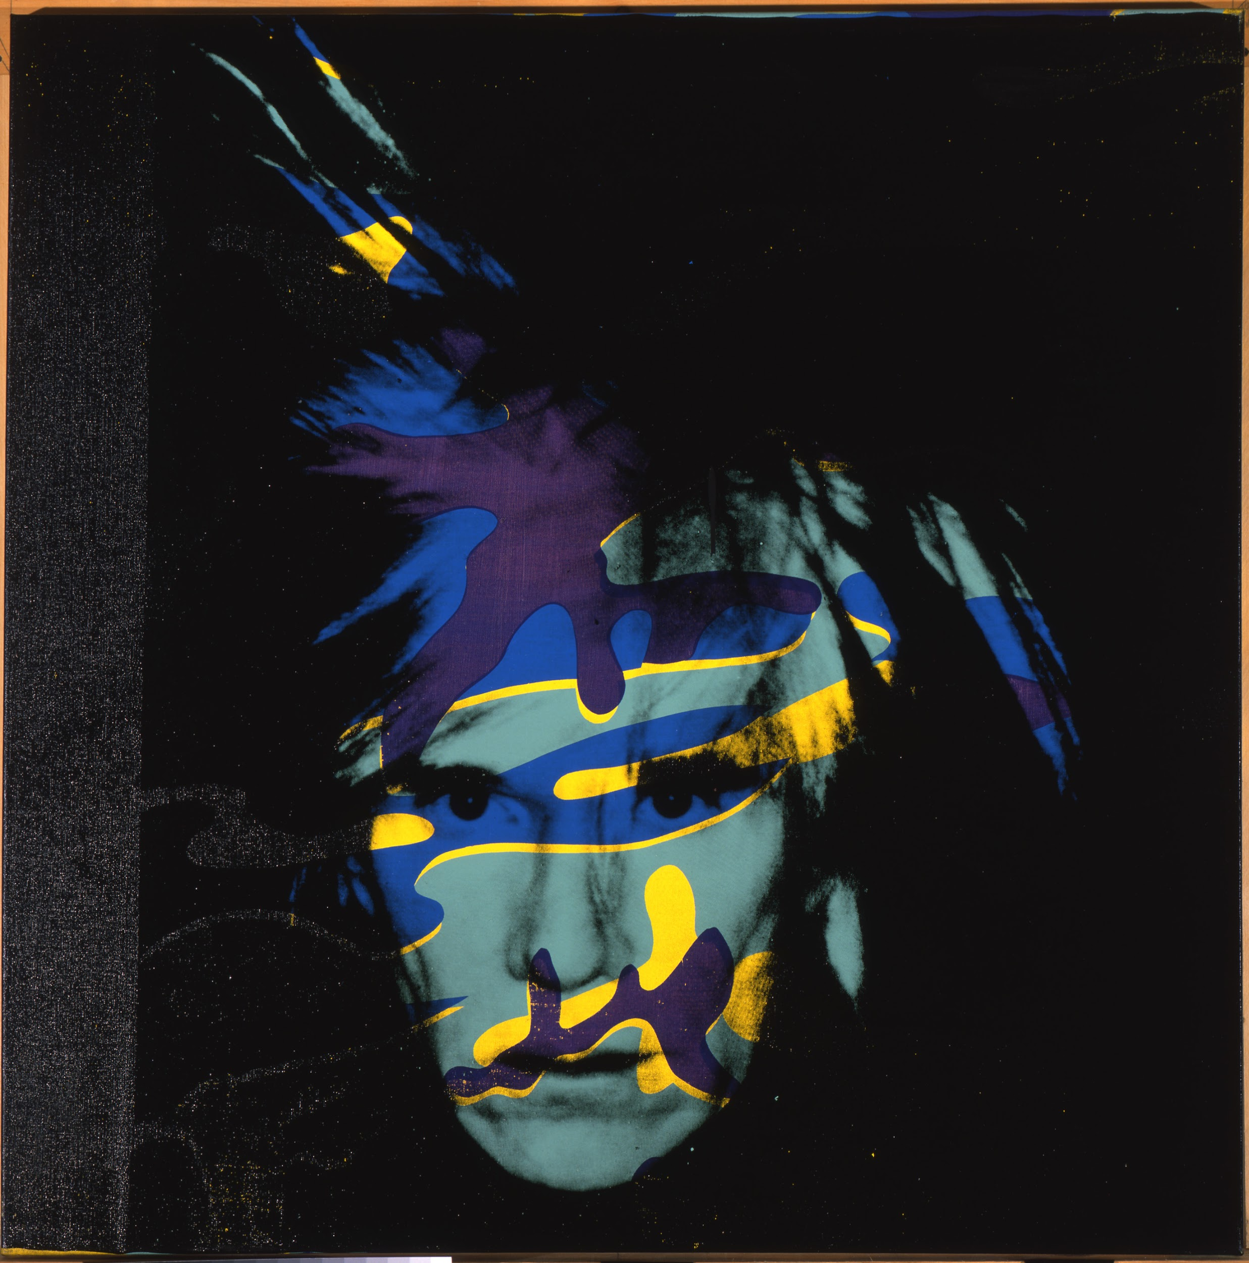
Andy Warhol dies at the age of fifty eight due to complications after gallbladder surgery.
Warhol is buried next to his mother and father at St. John the Baptist Byzantine Catholic Cemetery in Pittsburgh.
Plans to house The Andy Warhol Museum in Pittsburgh are announced in 1989, and the museum opens its doors during a twenty four-hour celebration on May 13, 1994.
February 22, 1987
Andy Warhol, Self-Portrait, 1986
The Andy Warhol Museum, Pittsburgh; Founding Collection, Contribution The Andy Warhol Foundation for the Visual Arts, Inc. 1998.1.819
Notes:
Additional Notes
About the Art: Andy Warhol, Self-Portrait, 1986.
Warhol’s vibrant camouflage paintings inspired the colorful camo clothing designed by his friend Stephen Sprouse. Warhol was buried in a Stephen Sprouse cashmere suit.
Other Notes:
Warhol’s grave site is viewable twenty-four hours a day, seven days a week through the collaborative project between The Warhol and EarthCam that we call Figment.
https://www.warhol.org/andy-warhols-life/figment/
Warhol’s funeral took place on February 27, 1987, at Holy Ghost Byzantine Catholic Church in Pittsburgh. Warhol is buried alongside his parents, Julia and Andrej Warhola, at St. John the Baptist Byzantine Catholic Cemetery. It is owned and operated by St. John the Baptist Church in Pittsburgh, a sister parish of St. John Chrysostom Byzantine Catholic Church, Warhol’s childhood church. EarthCam also has a live webcam inside this church.

Slide 32
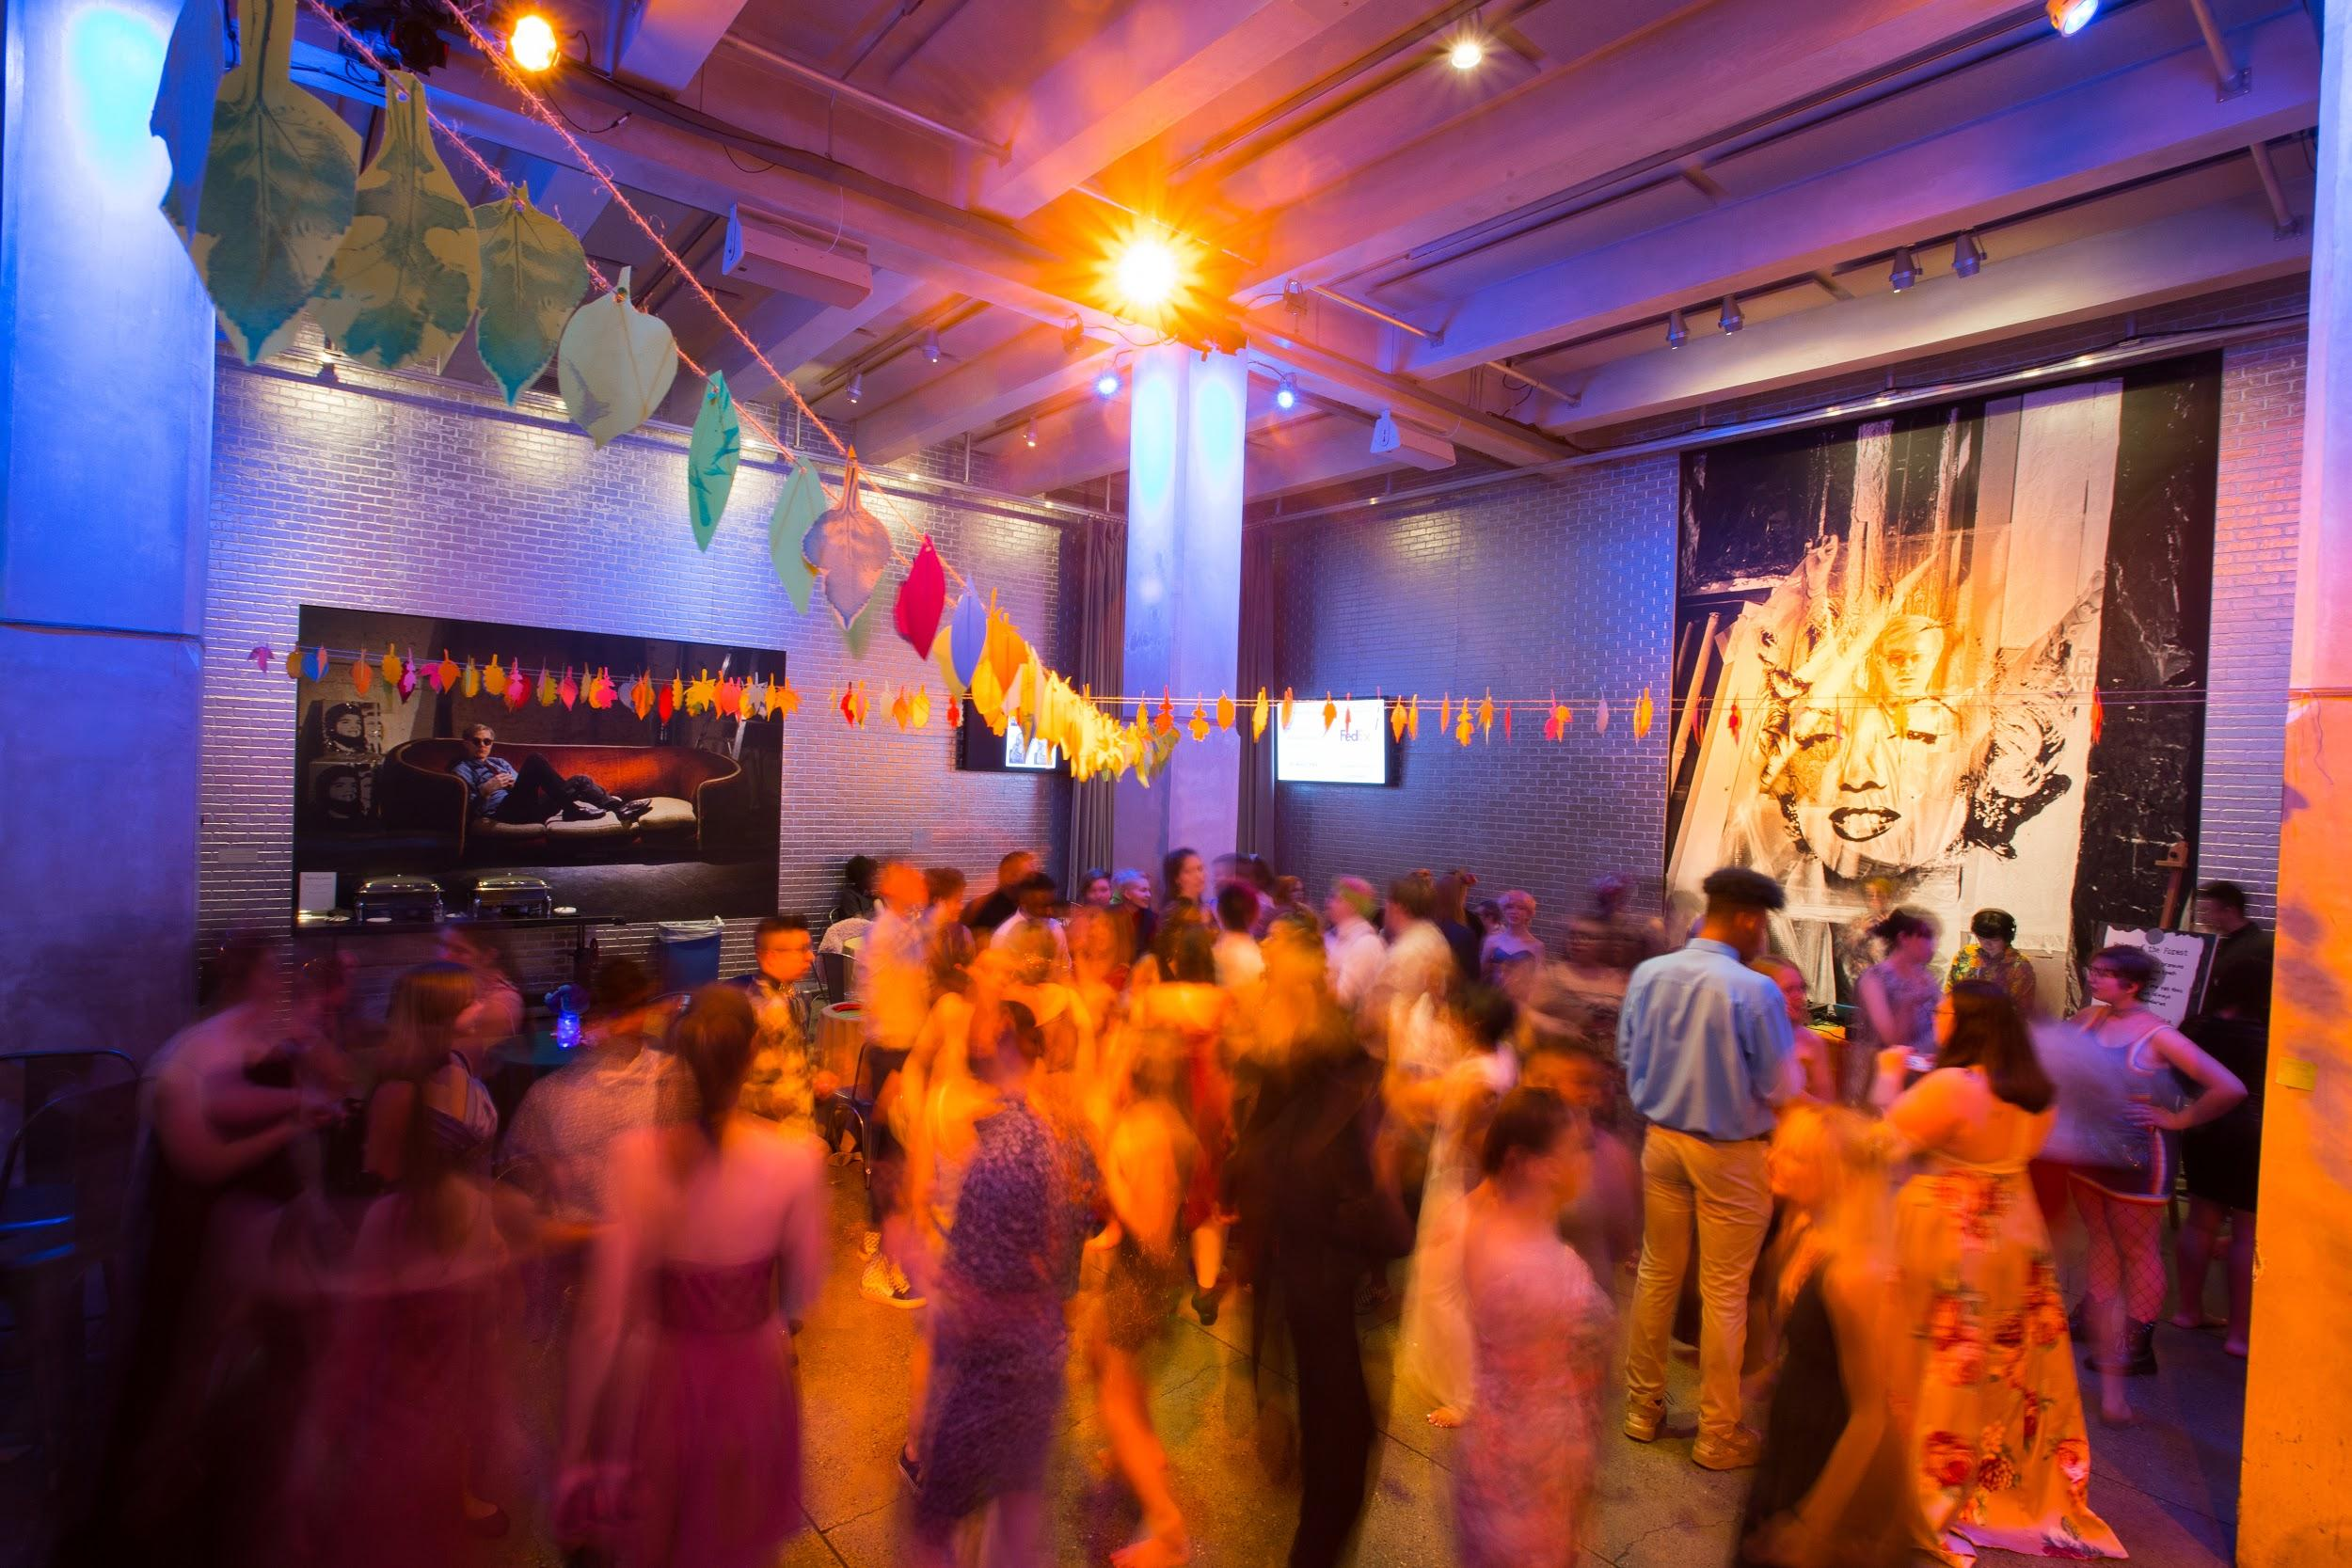
The Andy Warhol Museum presents a wide variety of Queer performance, programming, and events, including Western Pennsylvania’s largest LGBTQ+ youth prom.
Emergent scholarship on Warhol’s sexuality, such as the book Pop Out: Queer Warhol, has spurred new readings of his life and work.
Contemporary Queer visual and performing artists, such as Devan Shimoyama, Mickalene Thomas, and Sharon Needles cite Warhol as an influence and reference his work.
Warhol’s Queer Legacy
LGBTQ+ youth prom, The Andy Warhol Museum
Photo by Sean Carroll.
Notes:
Additional Notes
This photograph is from The Warhol’s 2019 LGBTQ+ Prom, which had the theme “Out of The Woods”.
Other Notes:
The museum’s website has compiled further LGBTQIA+ information and resources for educators: https://www.warhol.org/recommended-lgbtq-resources-for-educators/
The book mentioned above is Jose Esteban Munoz, Jennifer Doyle, and Johnathan Flatley, Pop Out: Queer Warhol (1996).
See Antwuan Sargent’s New York Times article “Seven Artists On The Warhol Influence” for more information on the ways Warhol has inspired a variety of visual artists: https://www.nytimes.com/2018/11/01/arts/design/seven-artists-on-the-warhol-influence.html

